Slide 1
Where Have All the Houses Gone?
Can we find a few new [affordable] housing units if we reduce utility interconnection prices?
Developed for: Commonwealth North Panel
Developed by: Mark A. Foster & Associates (MAFA), with support from Rasmuson Foundation
Preliminary Review of Data & Analysis
August 27, 2026

Slide 2
Thank you to Cook Inlet Housing Authority, Commonwealth North and Alaska Housing Finance Corporation for sponsoring the panel discussion
Thank you to the Rasmuson Foundation for financial support of MAFA data collection and analysis of housing markets, housing costs, utility interconnection costs as part of housing costs/prices, and potential ways to reduce utility interconnection prices to improve housing affordability.

Slide 3
FAQs for Commonwealth North Panel Presentation
Where have all the house [listings] gone?
How much does it cost to build a new housing unit in Alaska?
How much of the cost a new housing unit in Alaska might be driven by high and increasing costs for utility interconnections (main line extensions + service lines)?
How might we reduce housing costs (and prices) and improve housing affordability if we adopt economic development rates for utility interconnections?

Slide 4
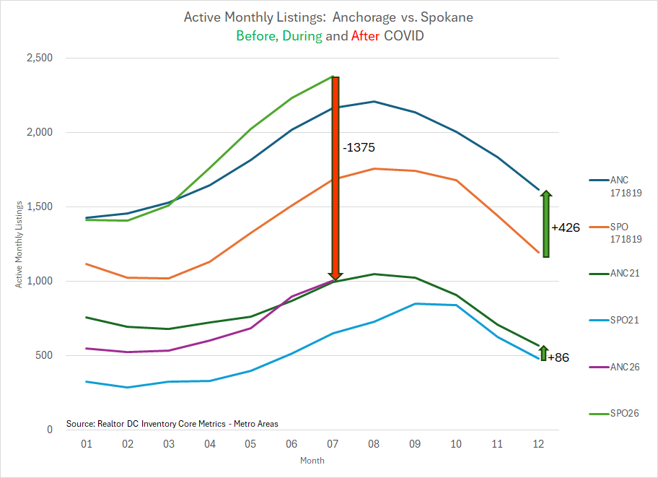
Where have all the house listings gone?
Vigorous
post COVID
recovery in
Spokane
Anchorage
remains in
the doldrums
After
Before
During

Slide 5
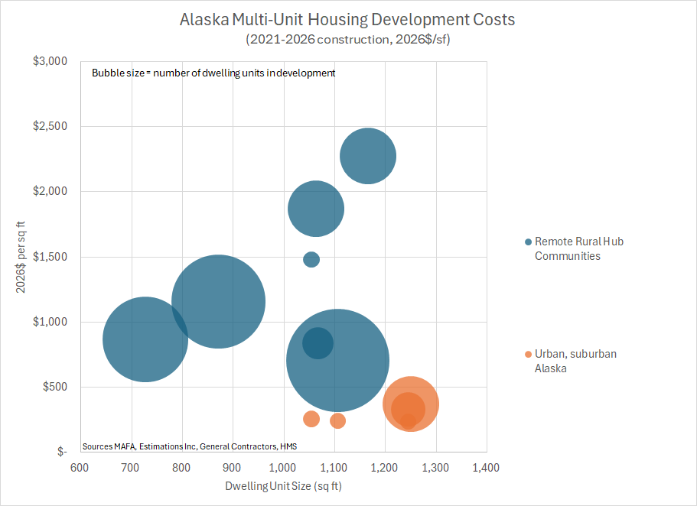
How much does it cost to build new housing in Alaska?
Four plex and above

Slide 6
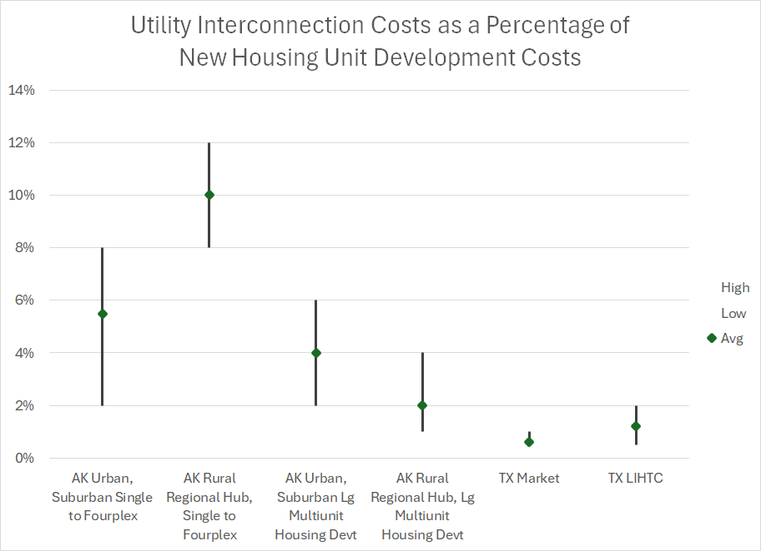
How much of new housing costs are driven by utility interconnection costs?
Urban, suburban and rural Alaska utility interconnection costs can be quite high (8-12% of total housing costs) for single unit through four plex scale developments. Local water wells and septic systems can be less expensive than piped system extensions.
Large apartment complexes (48 unit+) located within a block of a water/sewer main with “excess capacity” have significant utility interconnection economies of scale.
With limited frost, low water tables, aggressive utility expansion initiatives to support rapid growth, and historically robust labor supply, TX utility interconnection (and housing) costs remain significantly below other markets.
Sources: MAFA, Estimations Inc, RAND (2024-2026)
LIHTC = Low Income Housing Tax Credit Program

Slide 7
How much can we reduce housing costs (and prices) by shifting utility interconnection pricing toward economic development rates?
Natural Gas
  Southcentral – already started
  Interior Gas Utility – already started
Sewer – new opportunities
Water – new opportunities
Electric – new opportunities modeled on “economic development” tariff models

Slide 8
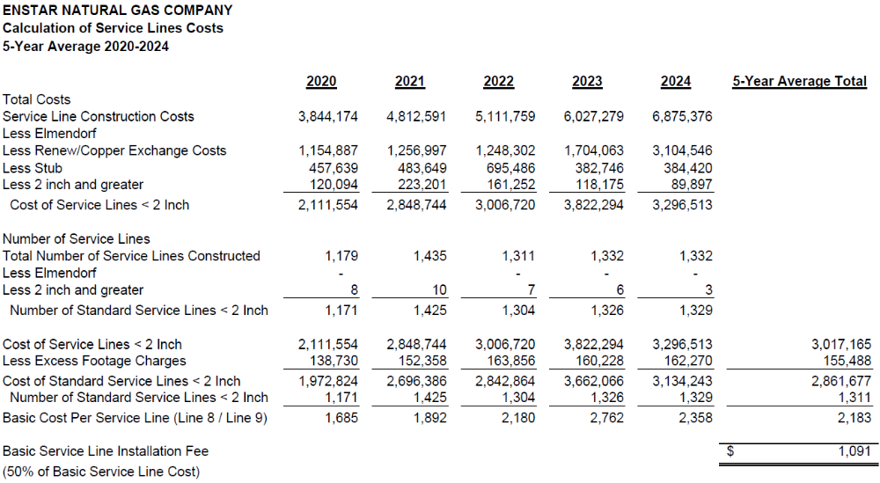

Enstar Service Line Fee = 50% Credit
Enstar is charging basic service line extension fees equal to 50% of the average cost of the previous five years of service line construction costs.
filed in 2025,
in effect in 2026

Slide 9
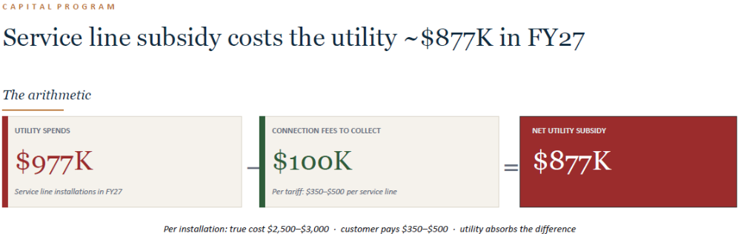
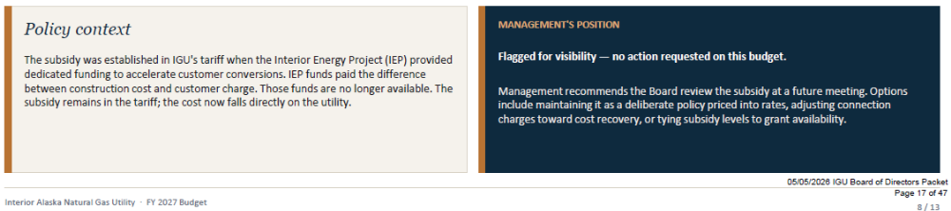
Interior Gas Utility: 90% credit

Slide 10
Basic policy premise for utility line extension credits
Provide a credit for line extensions for new utility customers in recognition of their future contributions to the fixed cost of the utility system, lowering fixed costs for all utility system customers
This is the same policy premise the Regulatory Commission of Alaska has accepted for special contracts/industrial scale customer pricing and “economic development” rates
The policy premise is frequently, but not always, associated with an assessment that the economic development rate covers the variable cost of service to the customer to assure existing customers that they are better off with the addition of the new customer with the economic development rate.

Slide 11
Intriguing example from L48
Residential customer utility line extension credit
  = discounted (at utility cost of capital) cash flow equal to seven years of residential customer’s rate contribution to utility fixed costs
Illustrative example
  Residential customer monthly infrastructure + customer services rate $50
  Fixed Costs as pct of infrastructure + customer service rates 80%
  Monthly residential customer contribution to fixed costs $40
  X 7 years $3360
  discounted back to present value at 10% (Weighted Avg. Cost of Capital) $2605

Slide 12
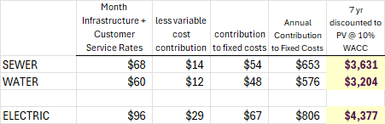
Illustrative Water/Sewer/Electric Utility residential customer credits against line extension costs to account for customer contributions to fixed costs applied to Alaska utility rates

Slide 13
Summary
Residential Line Extension Credit | Water | Sewer | Electric | Natural Gas
50% of cost |  |  |  | $1091
90% of cost |  |  |  | $2700
Discounted cash flow X 7 years of contribution toward utility fixed costs | $3200 | $3600 | $4300
Might utility line extension credits on the order of $13,800 (~3.5% of $400K) on a new housing unit help reduce up front costs, reduce prices and improve housing affordability?

Slide 14
Appendices
Approach
Key Findings
Supplemental Materials
  Cost elements of new homes
  Cost drivers
  Housing affordability trends
  Bibliography
  MAFA Statement of Qualifications

Slide 15
Approach
This report uses data from estimated and completed housing projects across Alaska, comparison states and Canadian provinces.
We adjusted costs to 2026$ using a combination of Engineering News Record Building Construction Cost, R.S. Means Commercial Building Construction Cost Indexes, and commodities and freight benchmarks, including futures markets.
We then conducted a variety of sampling exercises to explore and quantify the role of various factors in driving the cost differences we identified.
We interviewed real estate development, construction and utility project subject mater experts to identify potential explanations for what factors might be driving costs and how those cost drivers might be mitigated with economic development pricing of utility interconnection costs.

Slide 16
Key Findings
Rural Alaska is the most expensive region for housing production costs across the regions and cost categories we reviewed.
The per housing unit cost of utility interconnections for large multi-unit developments in rural Alaska appears competitive with other areas and smaller scale developments due to significant economies of scale in water/sewer connections.
The cost of housing production in Alaska urban and suburban communities is less than metro CA, but more than CO and TX. The cost of utility connections in Alaska urban and suburban communities appears to be significantly higher compared to CA, CO, TX.
Utility connection costs as a percentage of housing production costs were notably higher where utility depth of bury and length of interconnection were prevalent, e.g., sub-arctic regions where seasonal frost penetration in roads and right of ways can exceed 10 feet in depth.
Short construction seasons associated with severe and variable climate, remote location logistics, high freight and warehousing costs, and high cost of importing, housing and feeding skilled labor combined to increase direct costs as well as indirect costs associated with longer production timelines. In addition to increasing costs, the uncertainties associated with these challenges drove developers to increase their contingencies and risk adjusted return requirements which drove substantially higher prices for utilities and housing.
Reducing utility connection costs by XX% could reduce rental prices for new units by roughly YY%. This would enable the production of ZZ% more units for the same level of investment.

Slide 17
Supplemental Materials

Slide 18
Illustrative Supplemental Materials Figures and Tables
Cost elements of a new housing unit market price
History of utility connection/line extension cost drivers
Median Housing Price to Median Income, U.S. Metro Areas, 1980-2020
Western Metro Statistical Area Household Expenditure Survey, Housing Costs as Percentage of Income

Slide 19
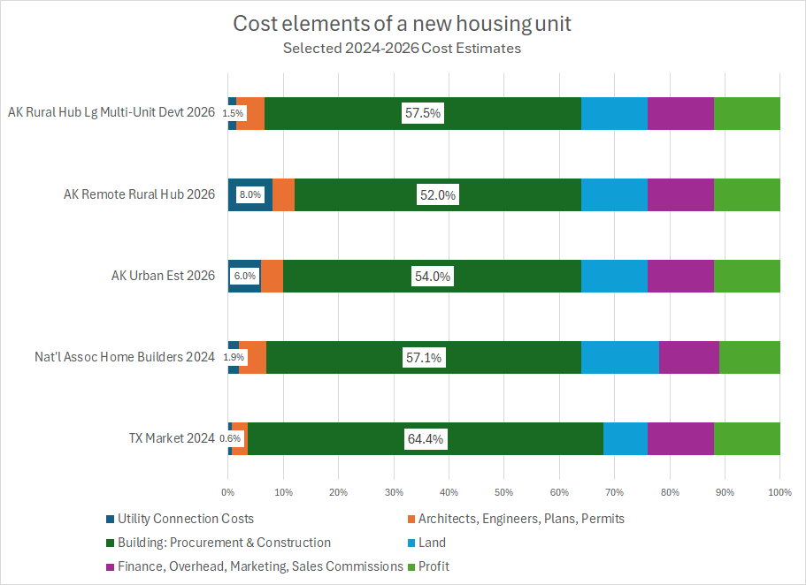
Figure S1. Cost elements of a new housing unit market price
Sources: National Association of Homebuilders Survey, 2025; Rand Housing Study, 2025, MAFA Preliminary Estimates, 2026

Slide 20
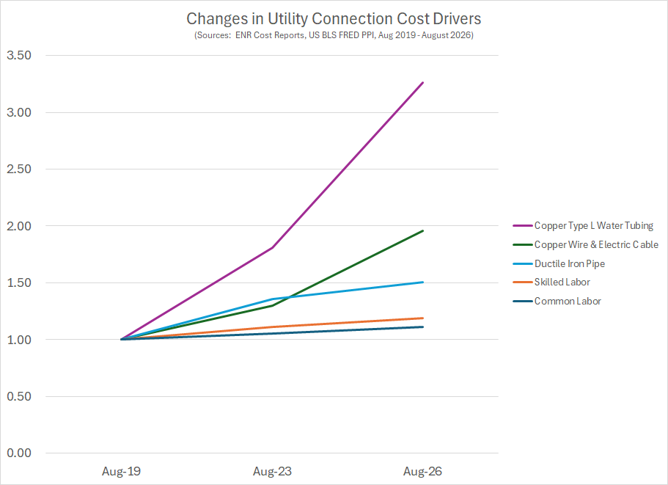
Figure S2. Recent history of utility connection cost drivers

Slide 21
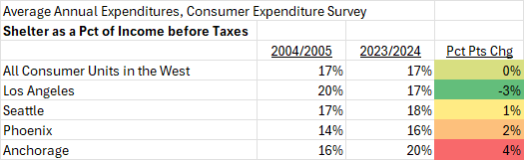
Figure S3: Western MSA Consumer Expenditure Survey:
Shelter Expenditures as Pct of Income before taxes
Anchorage shelter expenditures have outpaced income gains, as compared to CES selected Western MSAs and average of All Western consumers surveyed by CES

Slide 22
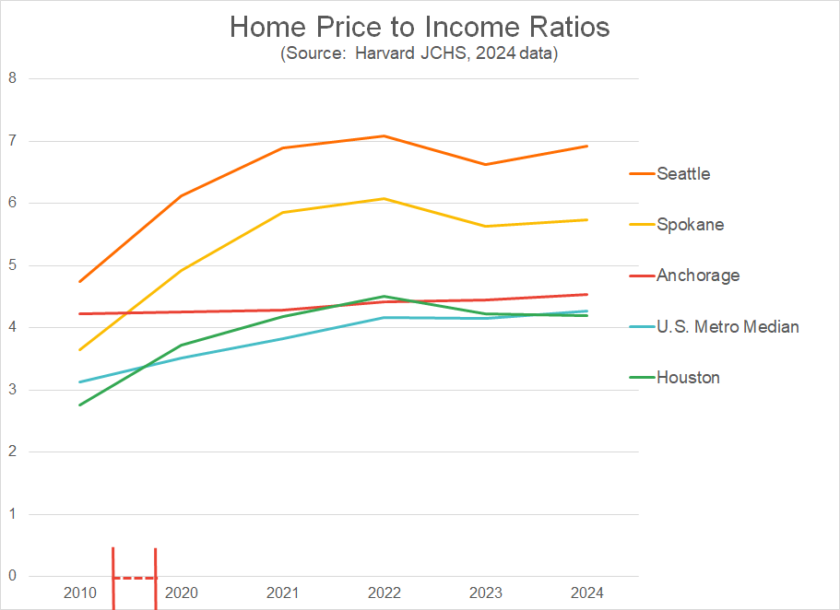
Figure S4. House price to income ratios

Slide 23
Bibliography
American Water Works Association, Beyond the Replacement Era: Balancing Compounding Infrastructure Needs with Housing Affordability, 2025
American Society of Civil Engineers, Infrastructure Report Card, Water, Wastewater, 2025
Anchorage Water Wastewater Utility, Project Grant Requests, Fiscal Year 2027
Baum-Snow, Nathaniel, and Gilles Duranton, “Housing Supply and Housing Affordability,” NBER Working Paper 33694, April 2025
Congressional Budget Office, Public Spending on Transportation and Water [incl. Wastewater] Infrastructure, 1956-2023, February 2025
Congressional Research Service, Wastewater Infrastructure Funding: Background and Affordability Issues, June 10, 2025, R48565
deRitis, Cristian, Ira Goldstein, Magge McCullough, Jim Parrott, Mark Zandi, “Bringing the Housing Shortage into Sharper Focus,” Moody’s, July 2025
ECONorthwest, “Oregon System Development Charges Study: Why SDCs Matter and How They Affect Housing”, Prepared for Oregon Housing and Community Services, December 2022
Engineering News Record, Construction Economics, Construction Cost Index, Building Cost Index, Materials Cost Index (1950-current)
Ericksen, Michael D., and Anthony W. Orlando, “A Cost Decomposition of Break-Even Rents for New Multifamily Housing Development,” Journal of Housing Economics, Vol. 66, December 2024
Gordian, Residential Costs with R.S. Means Data, 45th Annual Edition, 2026
Gordian, Site Work and Landscape Costs with R.S. Means Data, Division 33 Utilities, 45th Annual Edition, 2026
Gordian, Square Foot Costs with R.S. Means Data, 45th Annual Edition, 2026
Kolomatsky, Michael, “Rents are Flat – or Up, or Down, Depending Where You Look,” New York Times, March 7, 2024
Louie, Schuyler, John A. Mondragon and Johannes Wieland, “Supply Constraints Do Not Explain House Price and Quantity Growth Across U.S. Cities,” NBER Working Paper 33576, March 2025, revised August 2025
Louie, Schuyler, John A. Mondragon and Johannes Wieland, “Supply Constraints Do Not Explain House Price and Quantity Growth Across U.S. Cities,” Frequently Asked Questions, July 2025
Mattson, Jeremy, “Relationships between Density and per Capita Municipal Spending in the United States,” Urban Science, 5, 69, 2021
Ward, Jason M., and Luke Schlake, “The High Cost of Producing Multifamily Housing in California: Evidence and Policy Recommendations,” RAND Research Report, 2025

Slide 24
MAFA Statement of Qualifications
Stanford University, Senior Report, Civil Engineering, Susitna Hydroelectric Project Economic Feasibility Assessment [Railbelt hydro vs. Cook Inlet natural gas competition] (1982)
Fairbanks Municipal Utility System (FMUS), Chena Power Plant, Strategic Energy Supply Options Analysis, including natural gas pipeline vs. electric transmission from Alaska North Slope, Cook Inlet natural gas, Healy Coal, North Pole Refinery Supply Chains (1986-1987)
Fairbanks Municipal Utility System (FMUS), Chena Power Plant, Lead Project Engineer, Master Plan and Refurbishment Capital Improvement Plan in support of successful municipal public vote in favor of a revenue bond (1987-1989)
Salem Technical Services/Raytheon, Senior Engineer, Alaska Airport Capital Improvement Plan (1989)
Alaska Public Utilities Commission, Commissioner, Consumer/Engineering Seats, (1990-1993)
  Trans Alaska Pipeline System (TAPS) Tariff
  TAPS Quality Bank Tariff
  AIDEA Healy Clean Coal Project Certificate
  Railbelt HEA & MEA distributed generation vs. CEA Beluga Plant considerations
  ML&P Equity Management Plan
  Power Cost Equalization and Rural Utility Electric Service
Mark A. Foster & Associates (MAFA): Energy, Technology and Utilities Consulting (1994- 1999)
  Electric Power Alternatives for Thorne Bay
  Sutton-Glenallen Transmission Intertie Feasibility Study Review
  Kenai Peninsula Natural Gas Study
  Shallow Gas & Coalbed Methane Economic Reconnaissance Study
  Municipal Utilities Privatization Considerations
  North Slope Borough Service Area Ten Utilities Services Rate Studies, Revenue Requirements, Cost of Service and Rate Design
Mark A. Foster & Associated (MAFA): Economic and Management Consulting (2000-current)
  North Slope Borough Service Area Ten Utilities Enterprise Valuation Analysis
  Rural Utilities Operations, Maintenance and Management Studies
  FMUS Privatization: Revenue Requirements, Cost of Capital Testimony APUC/RCA
  North Slope Borough Service Area Ten Utilities Rate review and analysis of dismantlement, removal and replacement costs and funding alternatives
  State of Alaska Rural Energy Plan (electric & heating markets)
    Diesel fuel supply chain market analysis
    Low sulfur diesel fuel market implications
    Diesel electric generation efficiency: market model and analysis
    Wind energy market model & analysis
    Diesel combined heat & power market model & analysis
    End-use energy efficiency market analysis
    Utility operations and maintenance practices
    Utility cost of capital
    State and Federal energy policy
    Utility management performance review
    Executive Summary
  A&T Industrial Ecology: Analysis of Remote Rural Electric and Telecom Tele-maintenance Alternatives
  Denali Commission: Analysis of Rural Utility Sustainability Alternatives
  Natural Gas Demand and Supply Alternatives – Northeast Asia (Russia, China, Korea, Japan), in consultation with Arlon Tussing
  BP North America Review of GPA Budget
  Denali Commission: Statutory and regulatory changes to implement rural utility sustainability alternatives
  Coalbed methane leases and implications for surface owner property values
  Nuiqsut natural gas utility business plan and implementation strategies/program
  United Nations: Renewable Energy & Information & Communications Technology: Finance alternatives, case studies, technology forecast
  North Slope Borough Service Area Ten Utilities Annual Financial Report
  Agrium: Natural Gas Combined Heat & Power Plant For Fertilizer Export Facility: Railbelt natural gas and electric market assessment
  Alaska North Slope Natural Gas Pipeline Policy Issues, in consultation with UAA ISER team
  Railbelt Electric & Natural Gas Supply and Demand Outlook
  Alaska Household Greenhouse Gas Emissions by Region
  Review of Matanuska Electric Association Integrated Resource Plan
  Railbelt Utility Avoided Cost Calculations
  Cost of conversion to Ultra-low sulfur fuel across Alaska’s electric utilities
  Cook Inlet Regional Energy Sector and Utility Sector Opportunities (ANGDA)
  Analysis of Alaska Utilities’ Financial Capacity (ANGDA)
  Denali Commission: Benchmark construction cost model for power plants and bulk fuel handing and storage facilities
  Denali Commission: Alaska Construction Cost Outlook
  Alaska Public Infrastructure Replacement Cost Estimates in consultation with UAA ISER
  Review of Municipal Light & Power / Chugach Electric South Central Power Plant Joint Venture
  Bristol Bay Native Corporation Regional Energy Opportunities
  Lake & Peninsula Borough Regional Energy Plan
  NREL: Renewable Energy Opportunities in Alaska Report
  Alaska North Slope & Cook Inlet: Exploration Drilling Rig Opportunity Assessment
  Expert Testimony RCA Gas Balancing Tariff Case
  Natural Gas & Electric Economic Development Opportunities in Nuiqsut
  Analysis of Opportunities/Risks of Natural Gas Fired Combined Heat & Power Plant in Palmer
  Akutan Geothermal Energy Business Case
  University of Alaska Fairbanks, Long Term Combined Heat & Power Plant Financial Opportunities and Challenges
  Long Term Oil & Gas Development Opportunities & Pipeline/Tanker Transportation Opportunities
  National Energy Policy Institute: Clean Energy Standard Opportunities & Challenges – A State by State Analysis
  NREL/UAA ISER: Clean Energy Options for Alaska
  Analysis of Alaska heating and electric fuel markets
  Analysis of Rural Energy Market Opportunities/Challenges
  Review of Chugach Electric acquisition of Anchorage Municipal Light & Power
  Estimate of the Benefit/Cost of Alaska Transition to Net Zero GHG Emissions by 2050
  Review of Railbelt Hydro Development Opportunities and Transmission Upgrades
  Cook Inlet Natural Gas Price Outlook, including LNG Import Model and Estimates
Chair, Board Audit Committee, Anchorage Municipal Light & Power (2009)
  Review of ML&P Integrated Resource Plan and Final Investment Decision to install new high efficiency LM2500+ and LM6000 CC units
Chief Financial Officer, Anchorage School District (2013-2016)
  Due diligence analysis of energy expenditures including: heating and electric requirements for 7.7 million square feet of facilities and school bus transportation services for Anchorage School District (diesel, natural gas, electric options); potential investments in independent power production and power wheeling arrangements to mitigate future natural gas fired electric generation price escalation; combined heat & power projects to serve high schools, including municipal swimming pools; HVAC & building envelope capital replacement cycles
  Implemented program to accelerate LED lighting replacements
Chief Financial Officer, Peter Pan Seafood LLC (2021)
  Due diligence analysis of marine transportation (tender fleet, fishing fleet) and fish processing plant power plant capacity and energy efficiency improvement options

