Slide 1

Alaska's Housing Shortage: What We Control and What We Don’t,
Local Government Edition
Commonwealth North
2026-08-27
Office of Community and Economic Development
Bob Doehl, Director

Slide 2

What We Cannot Control
Interest Rates
Shipping costs & fuel surcharges
Inflation
Economic volatility
Supply/quality of land available for development
Energy availability and costs
Offsite infrastructure need and costs*

Slide 3
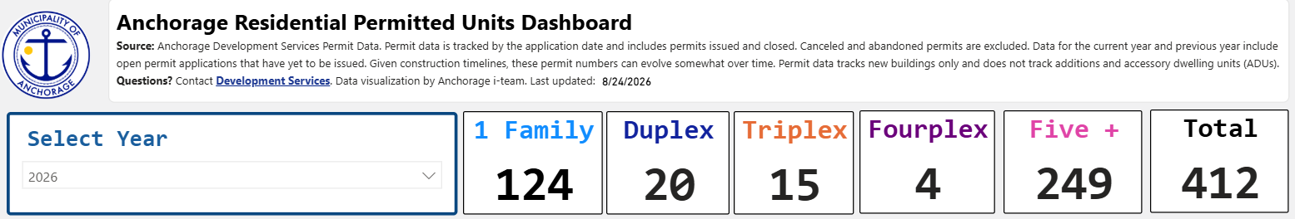
Anchorage is building more housing, and more types of housing.
33% growth in new dwellings permitted comparing 2024 to 2025.
Surpassed 2024 total in July, surpassed 2025 total in August.

Slide 4
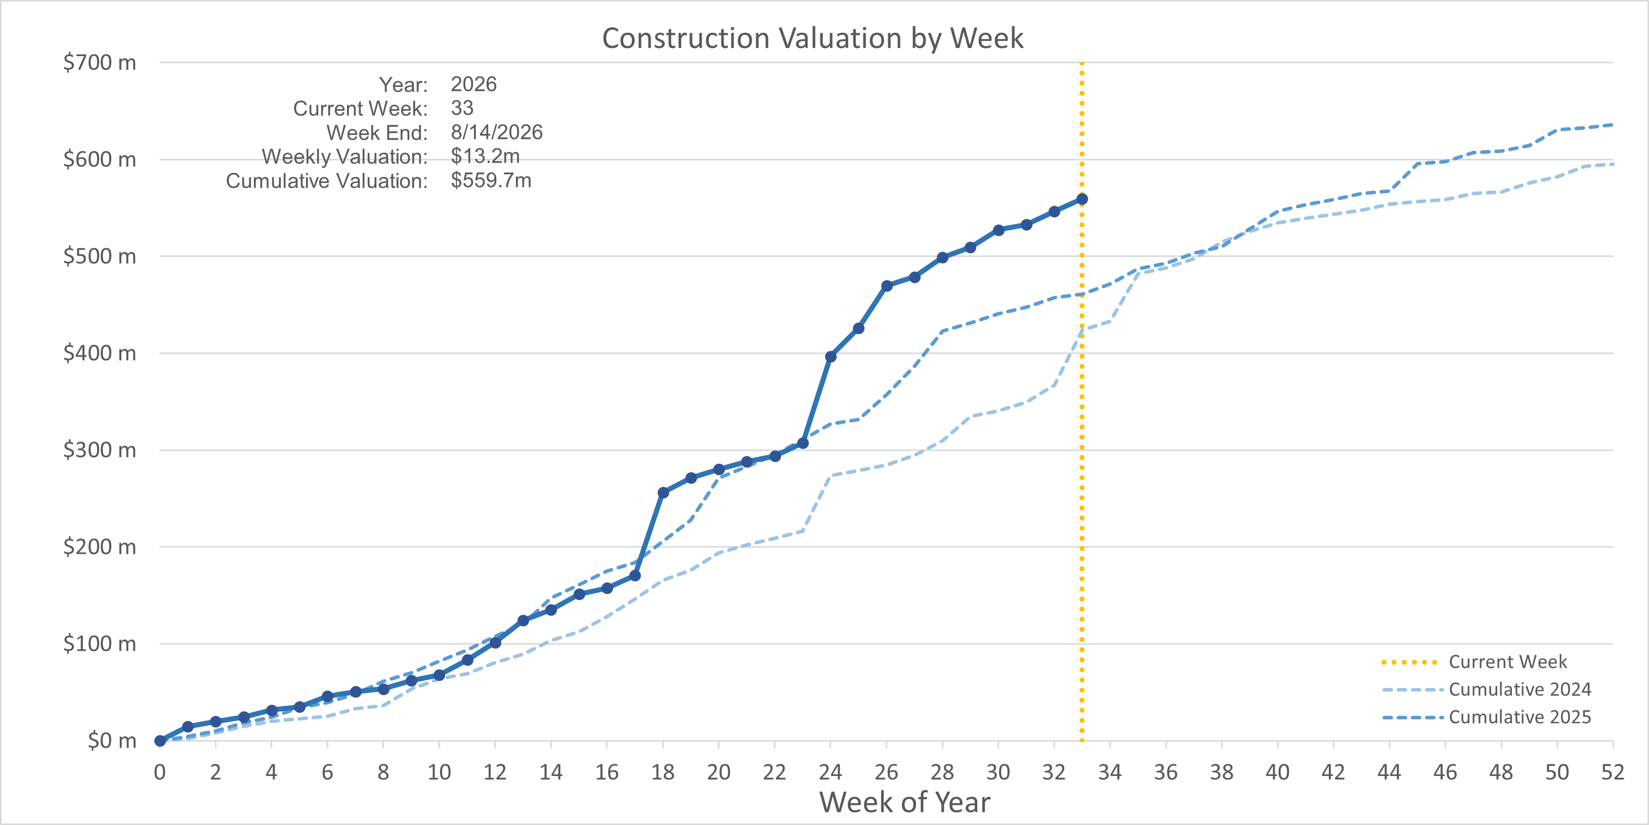
Construction valuations continue to rise
2026 thus far: $577.5million
22.5% / $106M ahead of the same time last year.

Slide 5




What we can do
Cut red tape. Remove regulatory barriers to help build and repair housing.
Streamline Municipal processes.
Unlock housing by increasing speed, efficiency,
and predictability.
Incentivize construction and repair.
Bring Municipal resources to the table to support housing.
Remediate neglect. Hold owners accountable for dangerous and
vacant properties.

Slide 6
Zoning code, Title 21, is shrinking, for the first time
We've taken significant steps to reduce the complexity of code.
For example:
Pause on design standards has reduced costs, uncertainty, and review times.
New streamlined rezone process allows property owners to upzone for just $200, if supported by the Comp Plan.
You don’t have to pave your driveway if you want to fix your bathroom. Changed rules for “non-conformities” to encourage rehabilitation and not require fixes to unrelated issues.
Coming Next: Process Improvements!

Slide 7
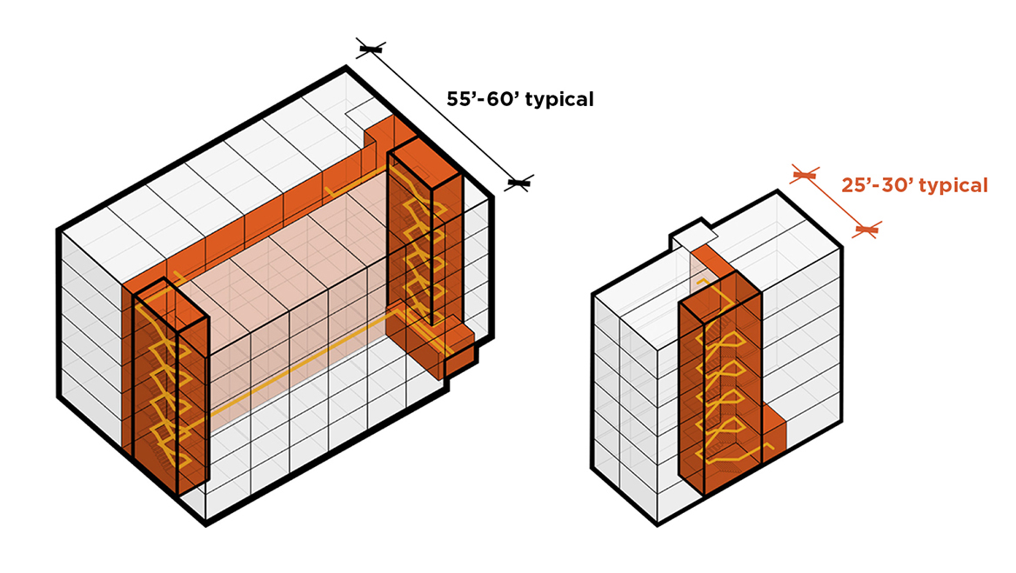
Modernized Building Safety, Title 23
Over 100 industry professionals and community members helped participate in the process of updating Title 23 to the 2024 international standards.
This update included an amendment that allows "single-stair" buildings up to 6-stories, which creates significant flexibility on small and oddly-shaped lots.
Coming next: New Permit System

Slide 8
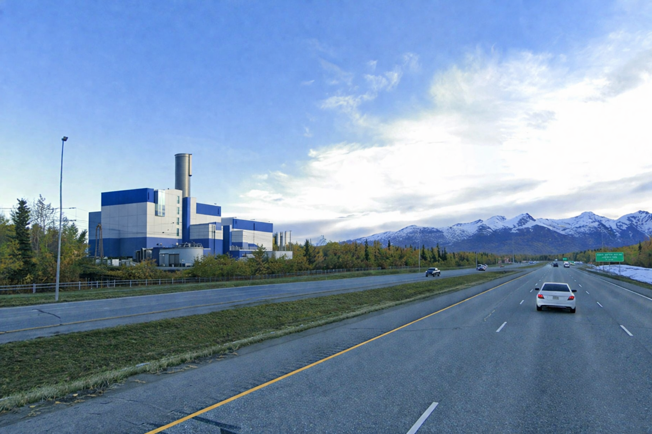
Lowering Operating Costs
Modern codes, rigorous seismic standards, qualified staff, and consistent enforcement ensure that Anchorage maintains a high ISO rating, which lowers the cost of private home and commercial insurance.
The ISO rating for building safety had dropped to 5. Was raised back to 3 after adopted of up-to-date building code, addressed staff continuing education and public outreach.
Waste-to-energy project will reduce energy costs and expand landfill capacity, including for hazardous waste.

Slide 9
Show me the money: new tax incentives make development pencil
The Mayor established two new incentives in 2025:
Multifamily Tax Incentive. Up to 28 years on new units. Directly responsible for 386 new units in last two years.
Rehab Tax Incentive. Up to 10 years for units that had been vacant or abandoned. Supported 10 rehab projects in last two years.
Two additional incentives are currently being considered by the Assembly:
First-time home-buyer incentive.
Mixed-use / condo incentive

Slide 10
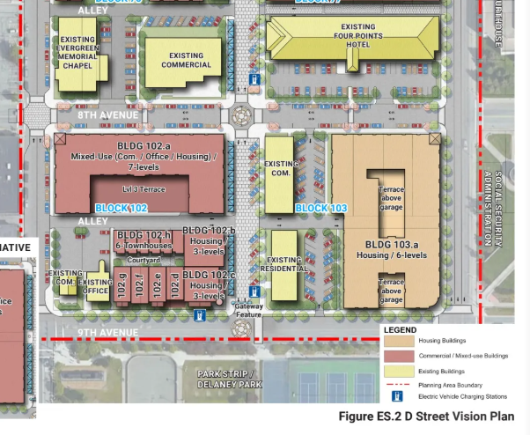
Skin in the game: obtaining and releasing land for development
Proposed swap with State of Alaska: Tozier Tract for Block 102 (pictured from the D Street Plan).
Will likely be disposing of excess Anchorage School District parcels.
RFPs to sell Archives, Totem sites recently closed.

Slide 11
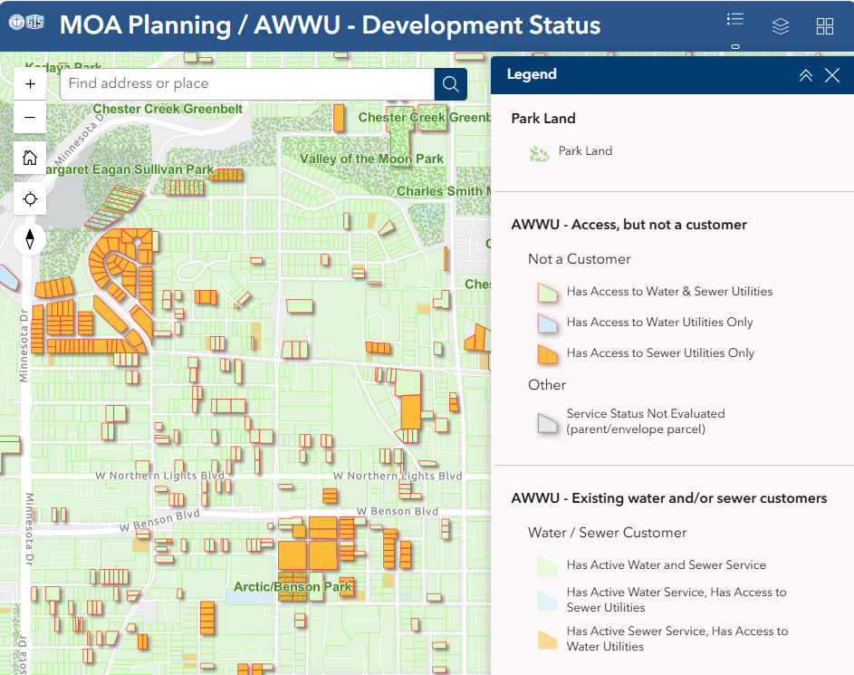
Shared information: New GDIC maps
Infill map merges information from Planning and AWWU to show developable land with utility connections.
Muni.org/plow shows live GPS of plows. Sanders will be tracked this year.

Slide 12
Questions?
Robert.A.Doehl@anchorageak.gov

