Slide 1


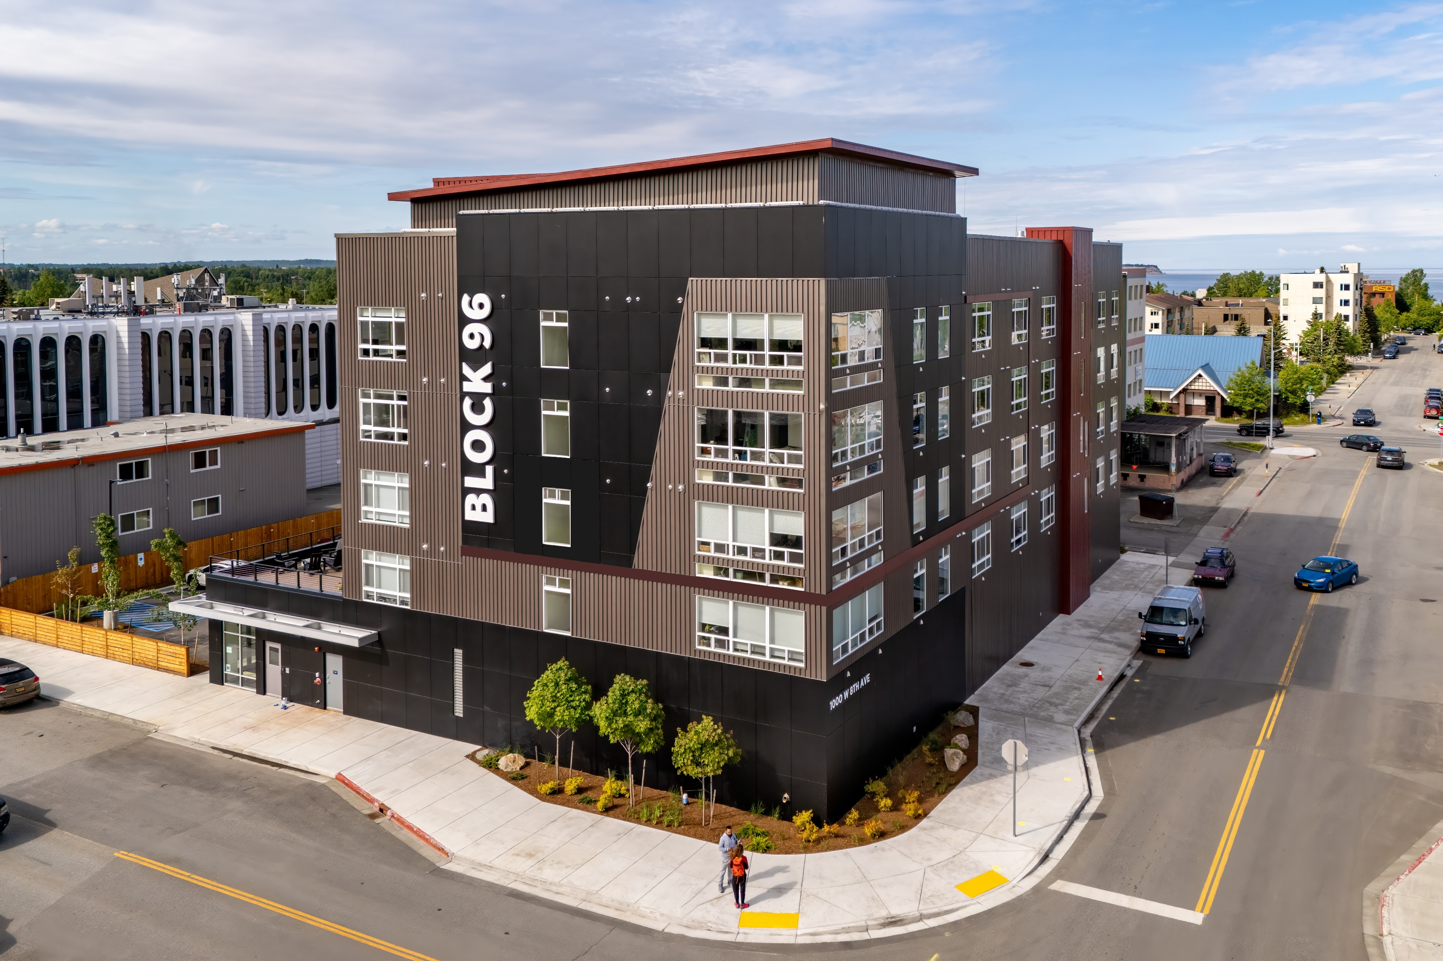
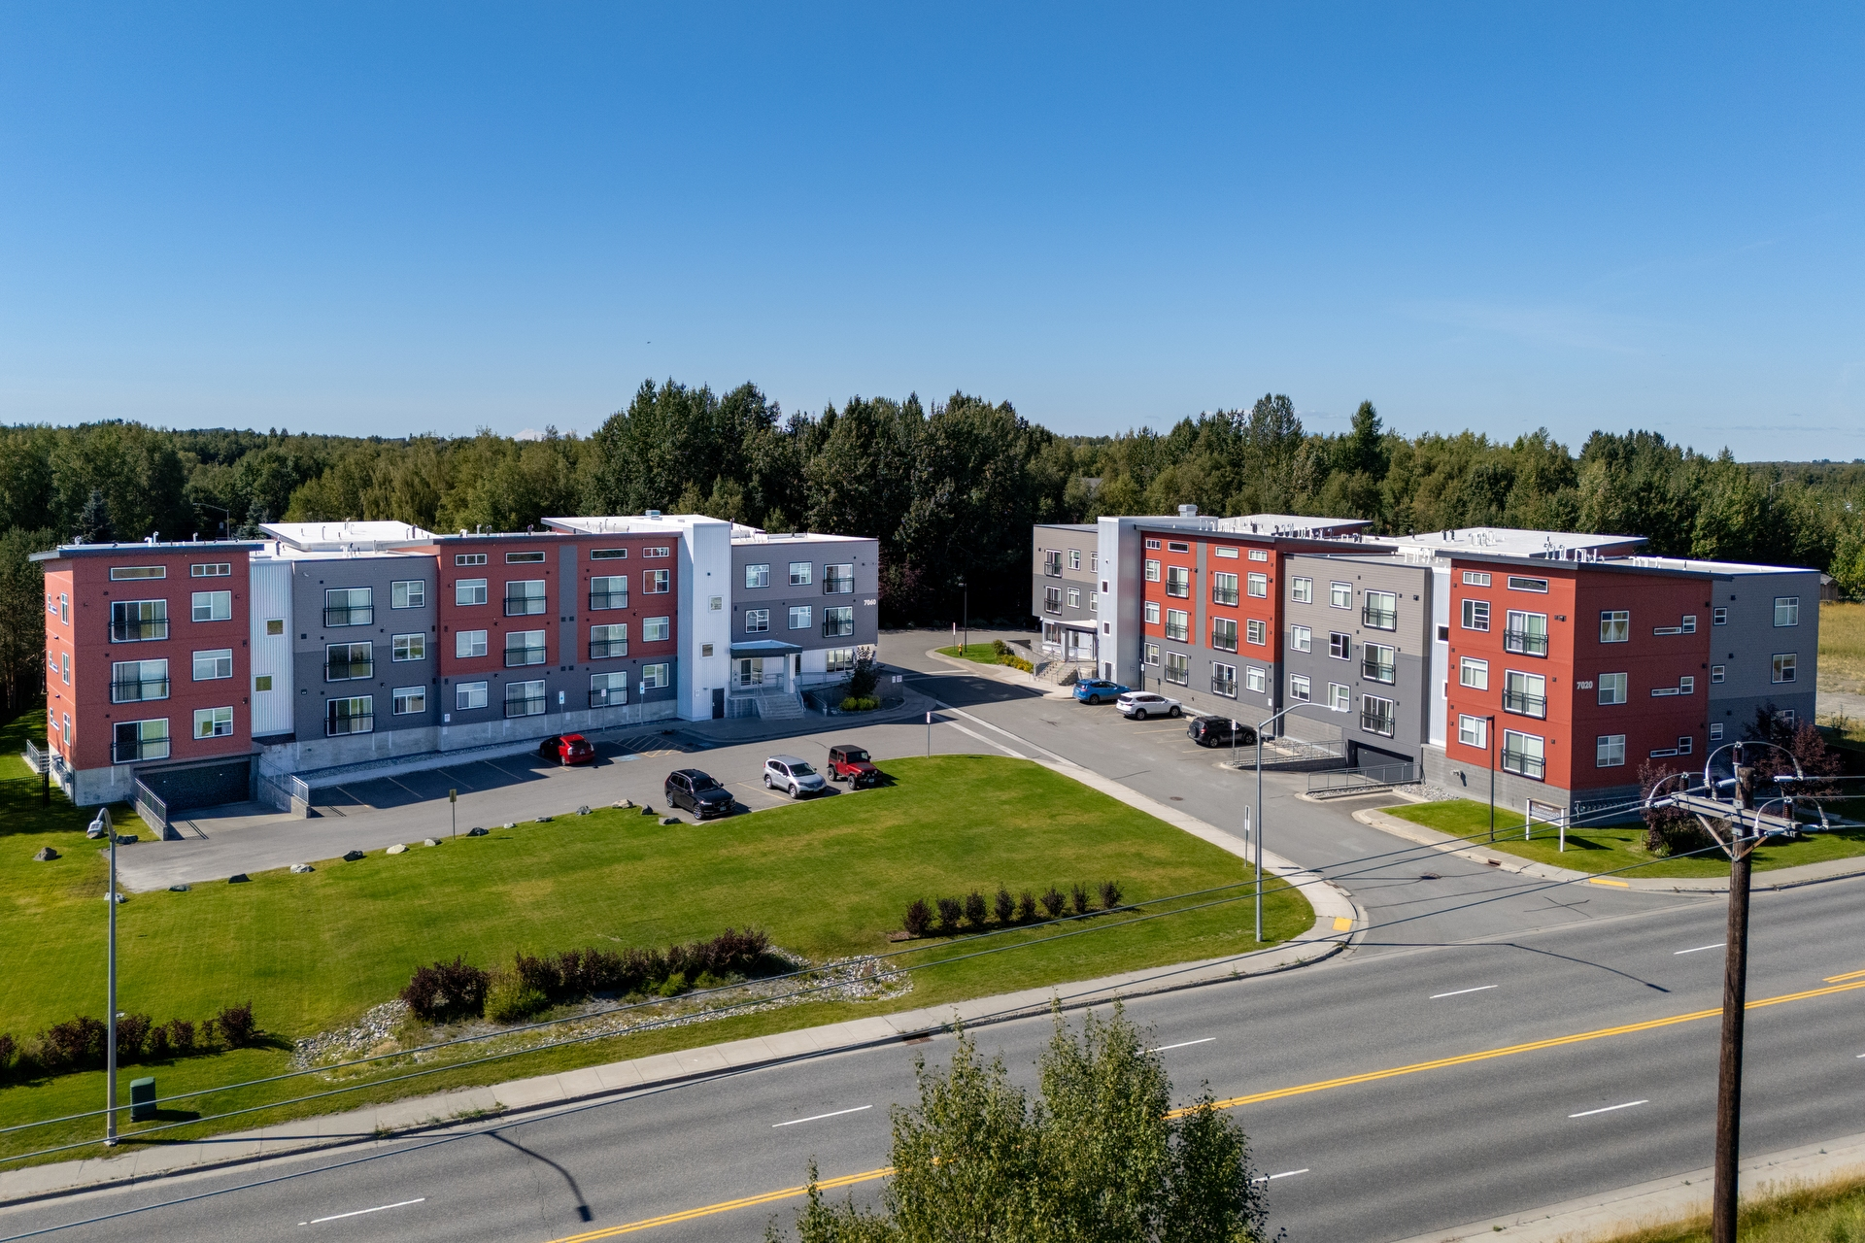
Shaun Debenham
Block 96
The Residences at Northwood

Slide 2
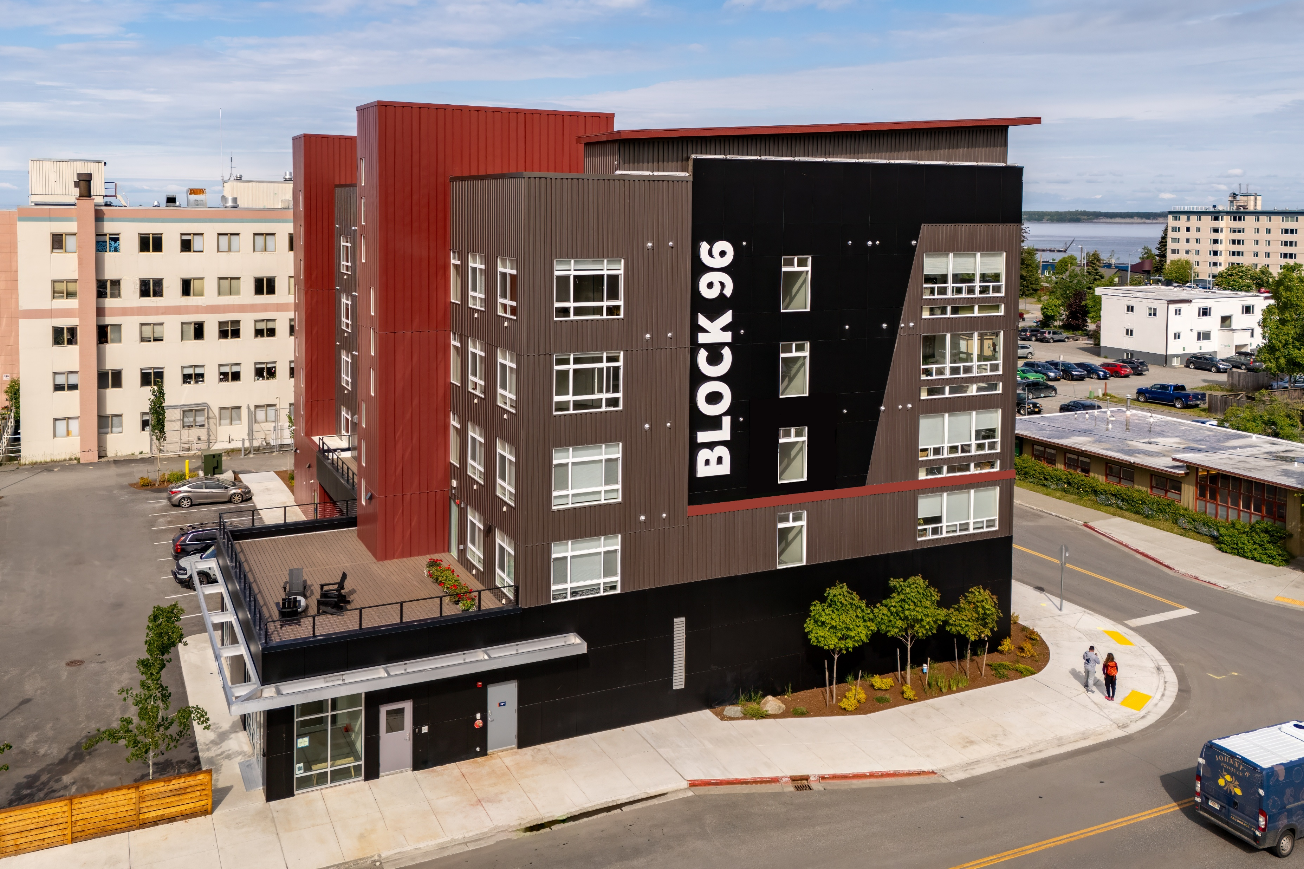

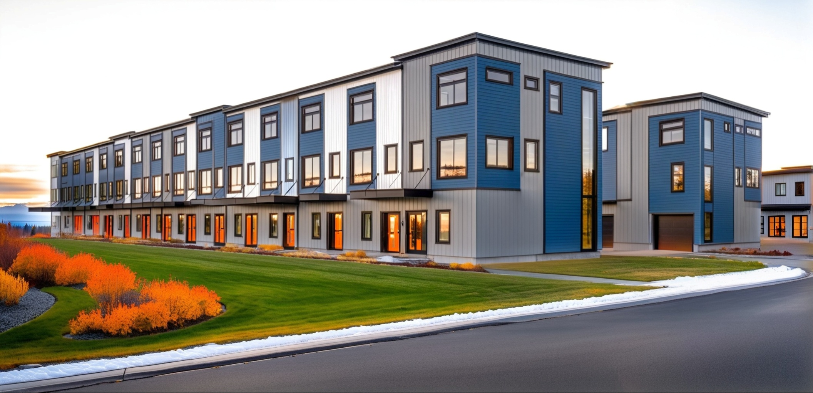

Block 96 – 48 homes
What’s Working?
Block 96 & Raspberry Townhomes
Tax Abatement
Design Standards Moratorium
Title 21 Changes
MOA Coordination
Raspberry Townhomes – 58 homes

Slide 3
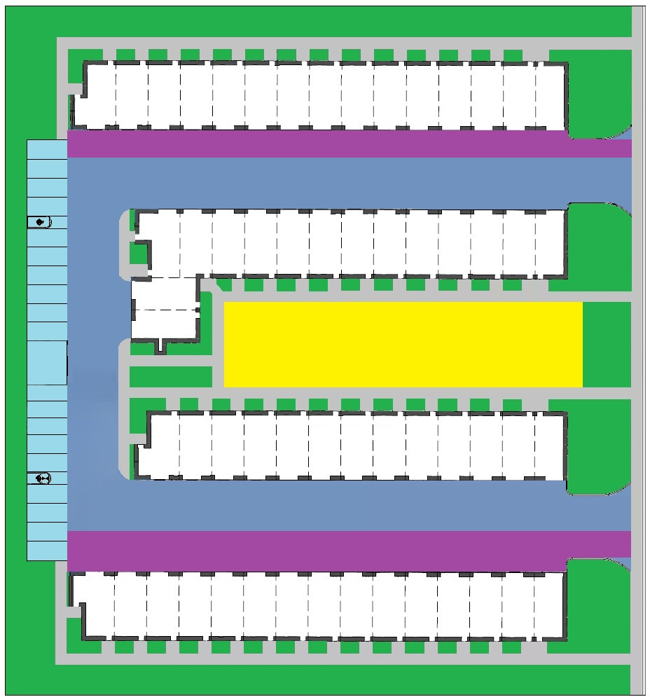
Raspberry Townhomes – Site Plan
What Need’s Work?
38’
Increase Site Efficiency
  Set Backs Analysis
  Fire Code Analysis
25’
Site Stats
R3 (40% Lot Coverage)
Actual Lot Coverage 30%
Fire Lane SF 7,520sf (15du)
44’

Slide 4

What Need’s Work?
CEA Tariff Change
  Change Chugach Electric North District Operating Tariff Section 8.6
  To allow Combined Heat & Power (CHP)

Slide 5

What Need’s Work?
Permitting
  Way too slow!
  Outsource review
  Outsource inspections

Slide 6

What Need’s Work?
Business Morale
  Morale is low
  Increase sense of safety
  Increase sense of value of property and business owners

Slide 7

Thank You!
Shaun Debenham
Debenham LLC
shaun@debenham.com
(907) 562-9330

