Slide 1
INSTITUTE OF SOCIAL & ECONOMIC RESEARCH · UNIVERSITY OF ALASKA ANCHORAGE
The Federal Workforce in Alaska:
What’s Changed?
Brock Wilson · Research Assistant Professor of Economics, ISER

Slide 2
Introduction
$1.5B
~15,500
3rd
in federal civilian wages paid in Alaska each year, averaging nearly $100,000 per job
federal workers live in Alaska
highest federal workforce share across all states
Source: AKDOL Trends Magazine May 2025
UAA · ISER | Federal Workforce in Alaska

Slide 3
Data
The source
Who's counted
Federal personnel records from the Office of Personnel Management — administrative micro-data covering essentially every federal civilian worker, plus point-in-time headcount snapshots
Federal civilian employees, excluding Defense, Postal Service, Homeland Security, and Justice
The window
What's measured
April 2024 to April 2026. The April snapshots bracket the whole episode — including the Sept. 30, 2025 buyout cliff — so departures that posted at fiscal year-end are captured.
Net change = everyone hired minus everyone who left (the freeze, retirements, buyouts, and firings together)
“Cuts” = RIFs plus probationary terminations above normal, reported separately and as a conservative lower bound
Why this −14.8% looks larger than the ~10% in the news: it covers non-defense agencies only, runs two full years through April 2026, and is net of the hiring freeze and attrition — not cuts alone. Active-duty military is excluded, and the April 2026 snapshot is provisional.
UAA · ISER | Federal Workforce in Alaska
Notes:
Plain-language version: this is administrative data on basically every federal civilian worker, not a survey. I drop Defense/DHS/Justice because their locations aren't reliable, and I look April-to-April so the whole episode is in frame. 'Net change' is everyone in minus everyone out; 'cuts' specifically means RIFs and probationary firings. That's why my number is bigger than the headline 10%.

Slide 4
Background
Notes:
Plain-language version: this is administrative data on basically every federal civilian worker, not a survey. I drop Defense/DHS/Justice because their locations aren't reliable, and I look April-to-April so the whole episode is in frame. 'Net change' is everyone in minus everyone out; 'cuts' specifically means RIFs and probationary firings. That's why my number is bigger than the headline 10%.

Slide 5
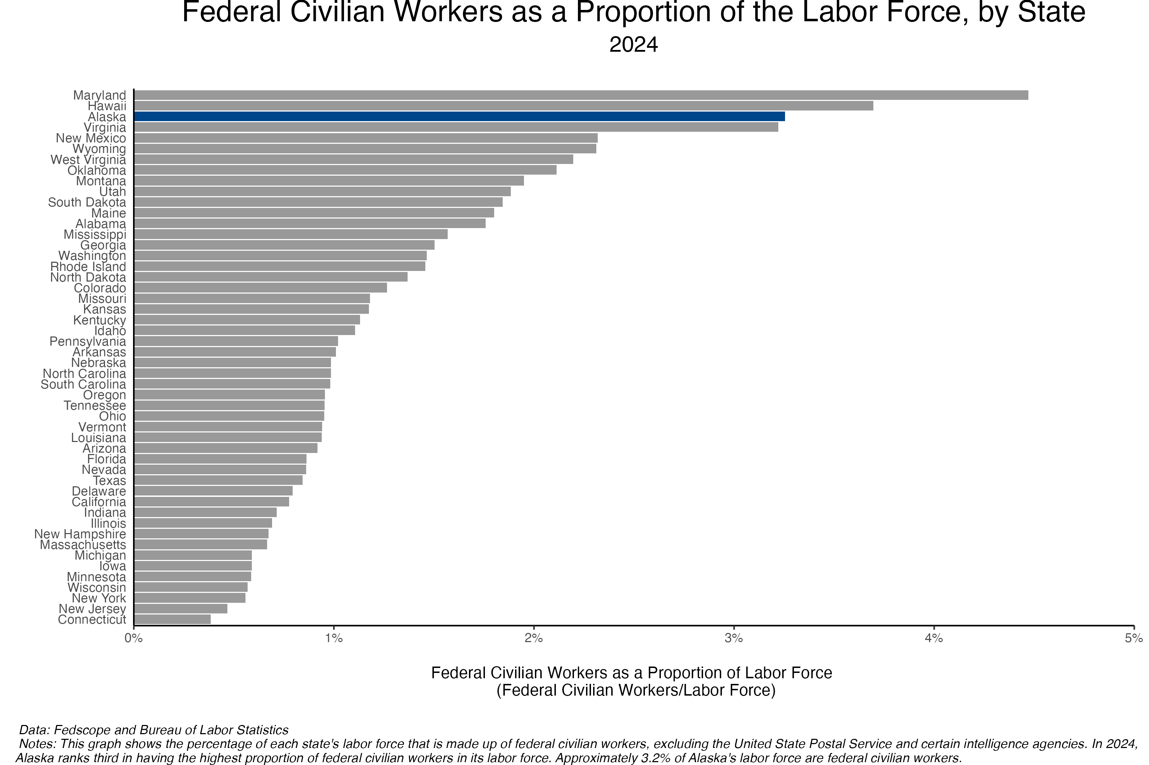

Slide 6
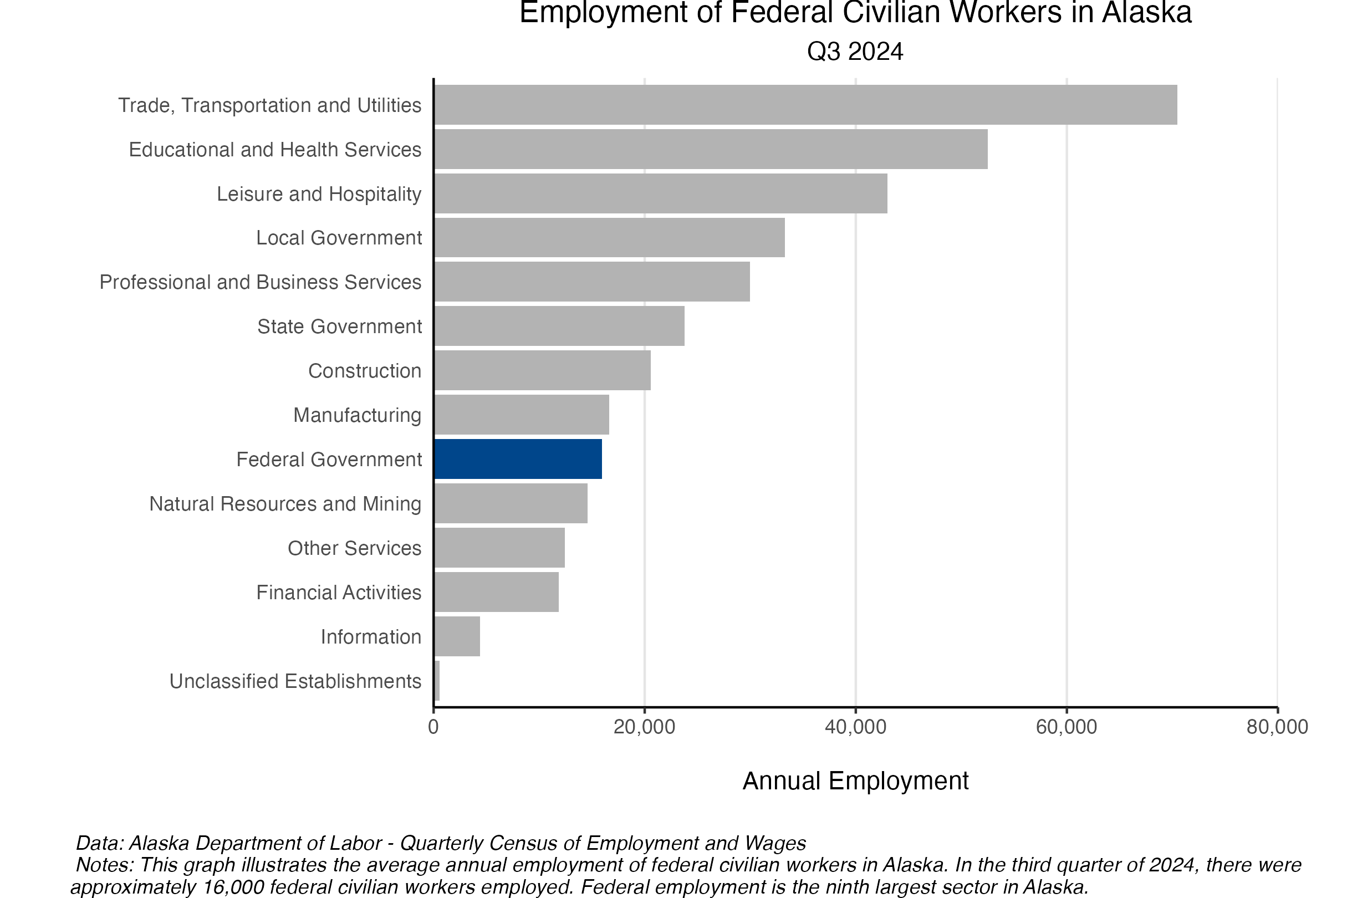

Slide 7
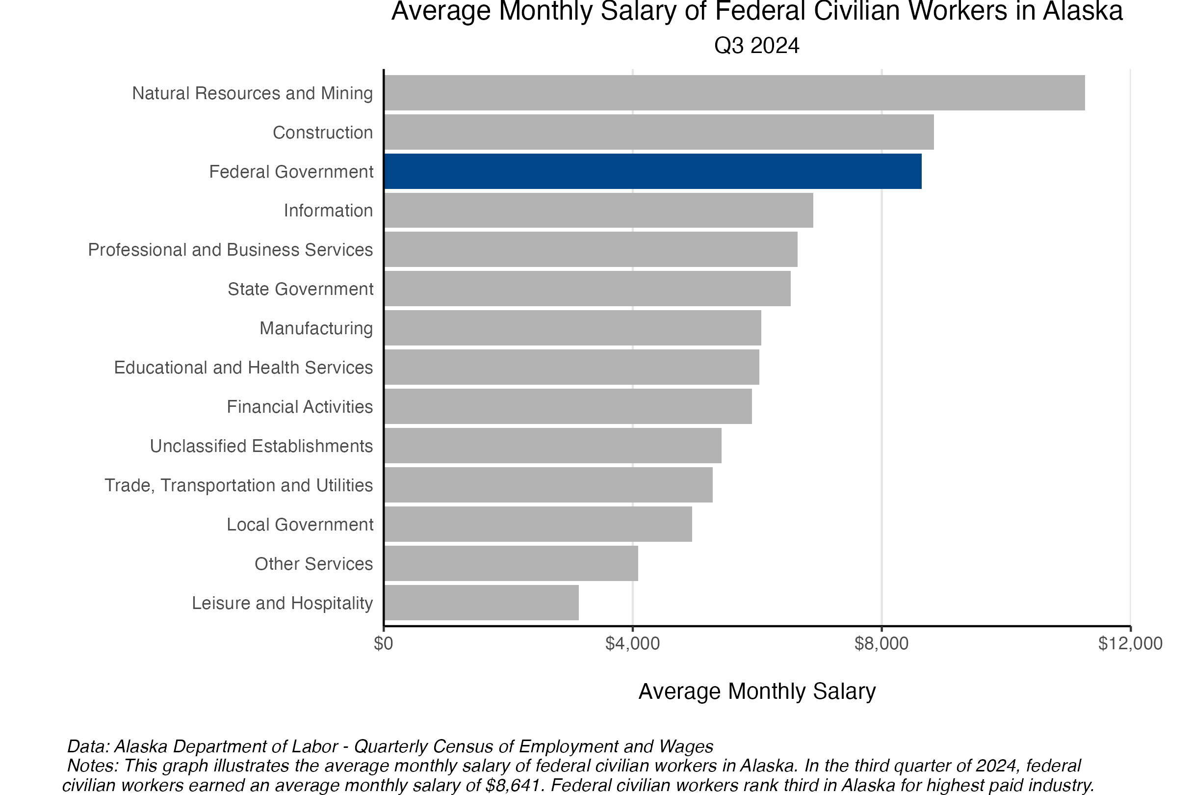

Slide 8
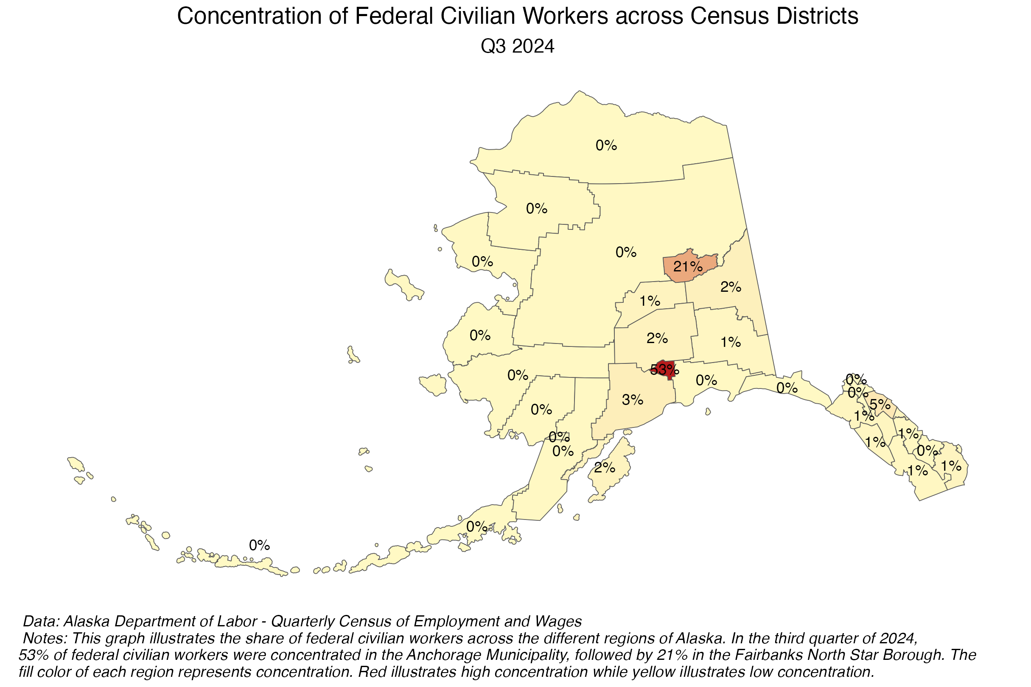

Slide 9
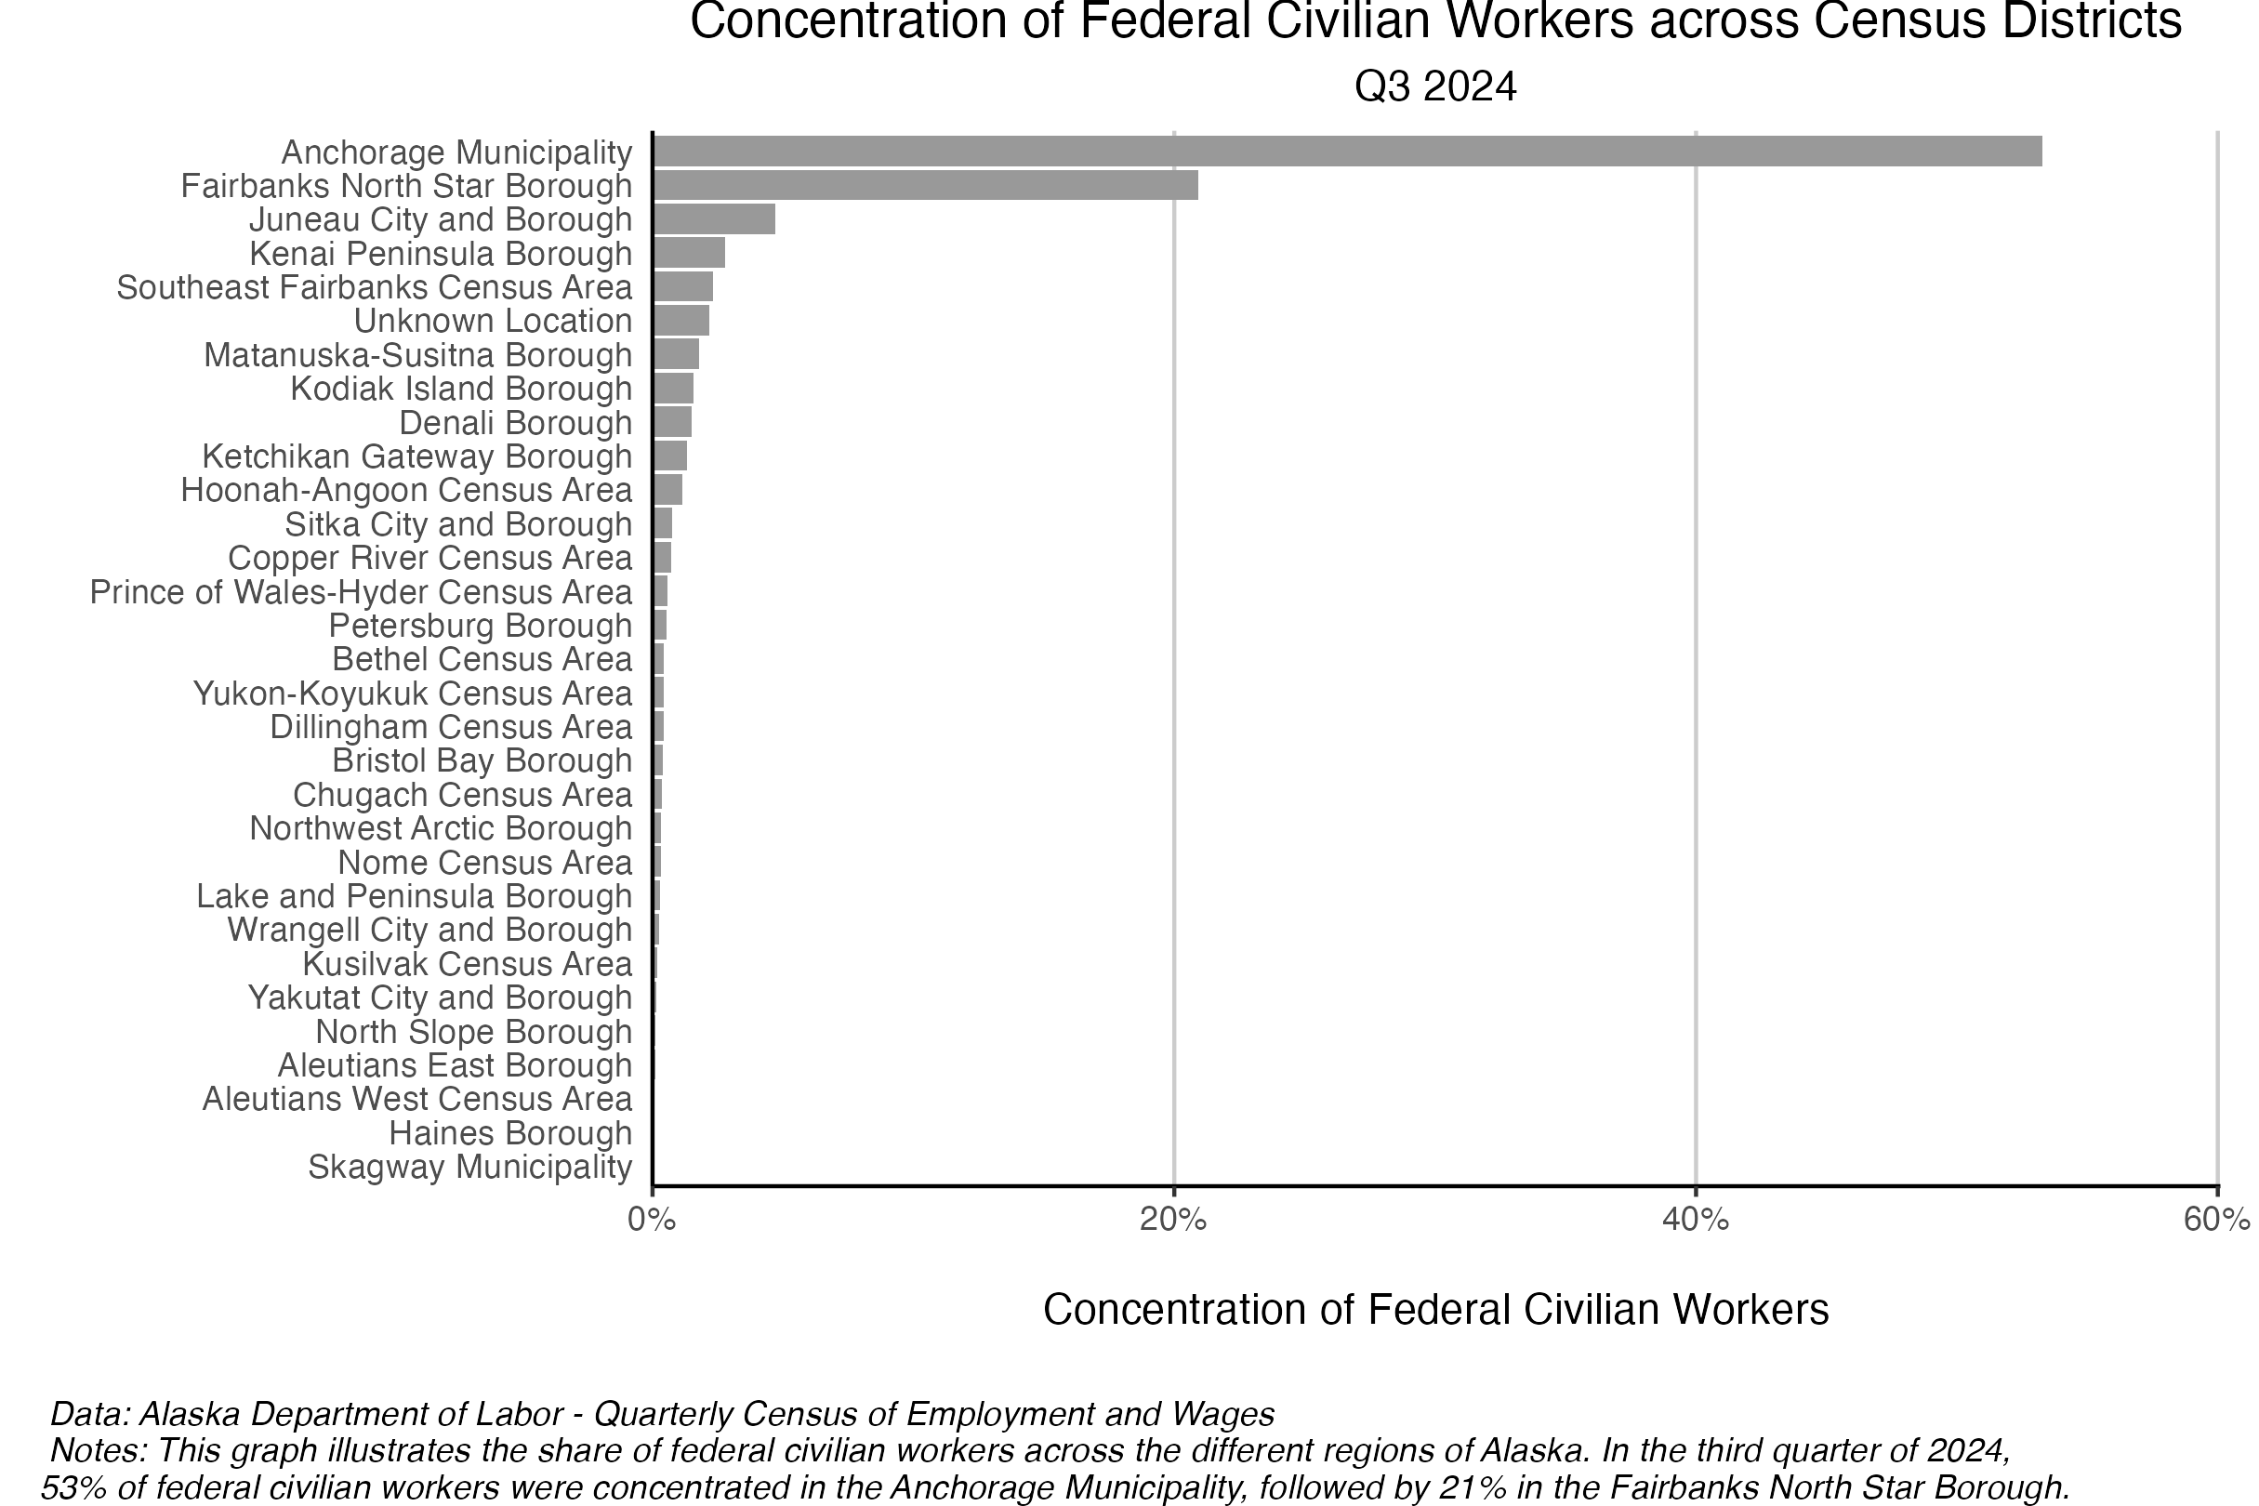
Federal worker concentration by census area — bar

Slide 10
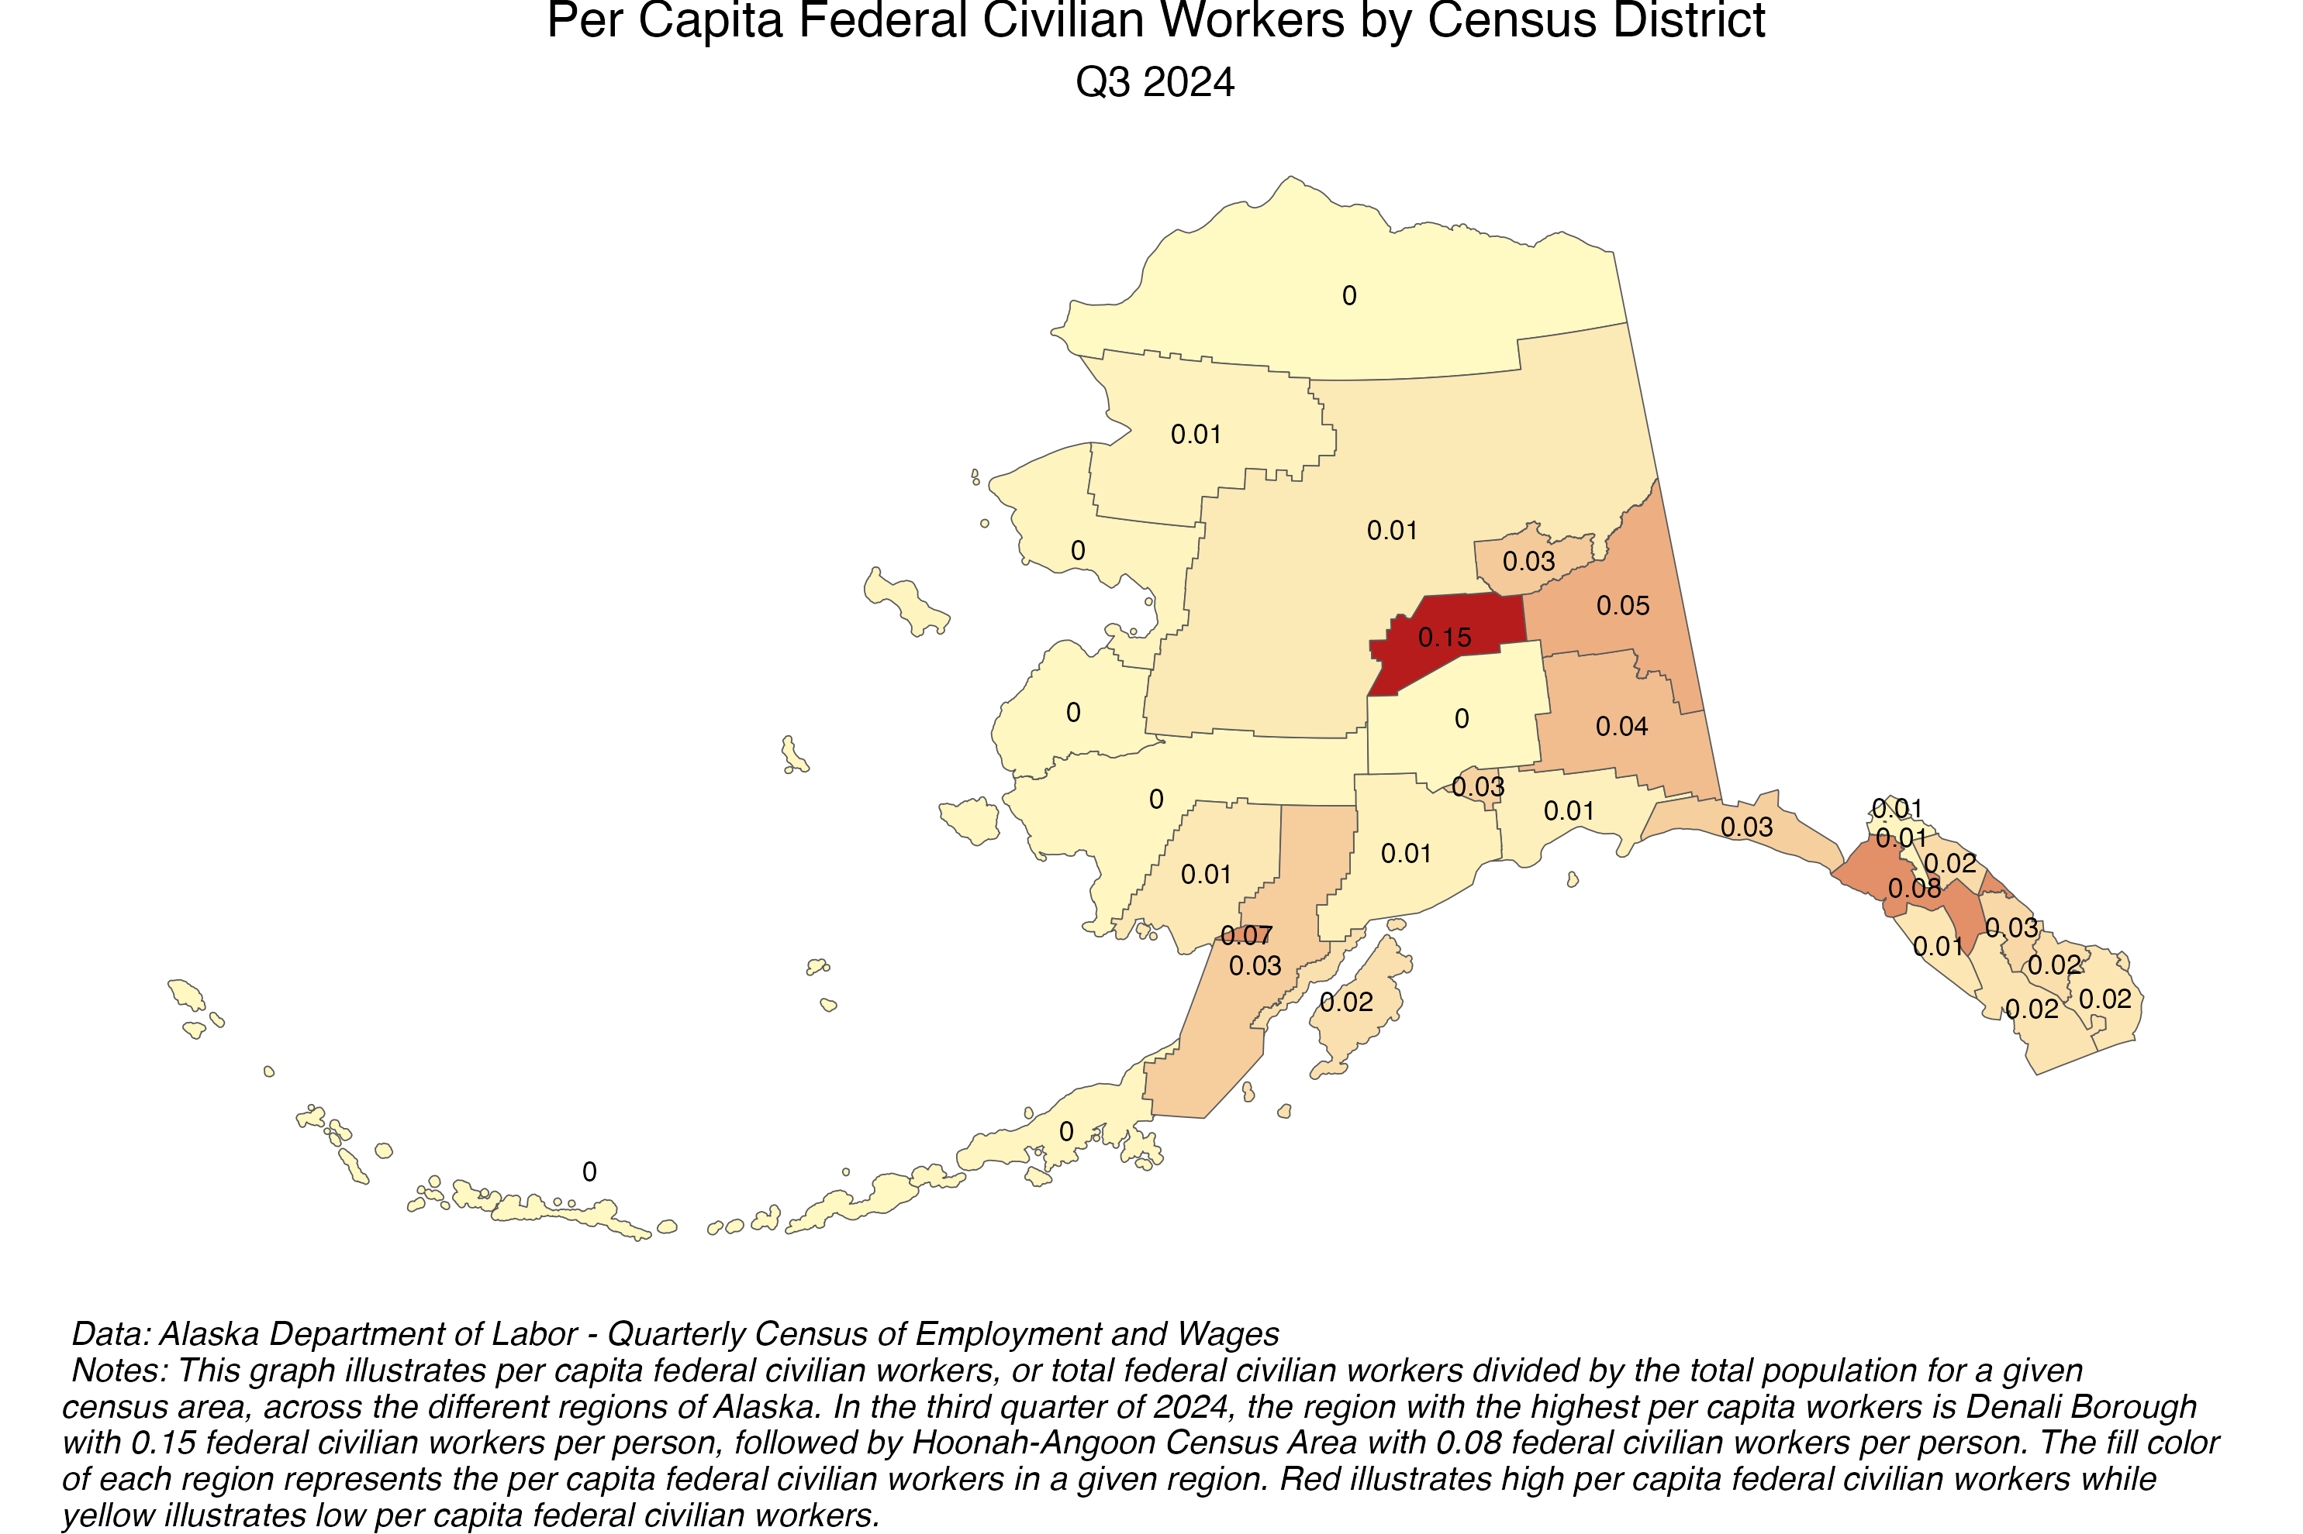

Slide 11
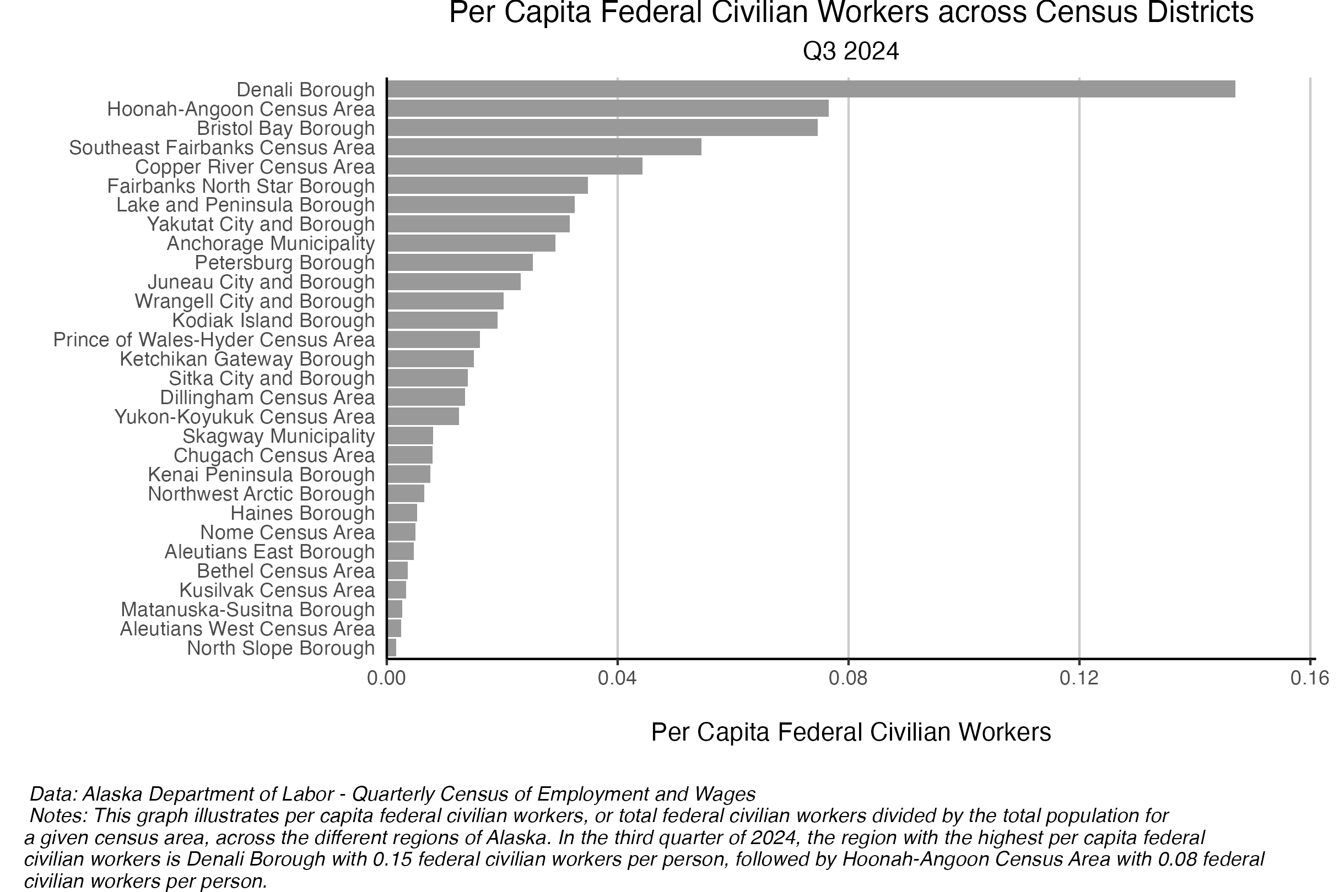

Slide 12
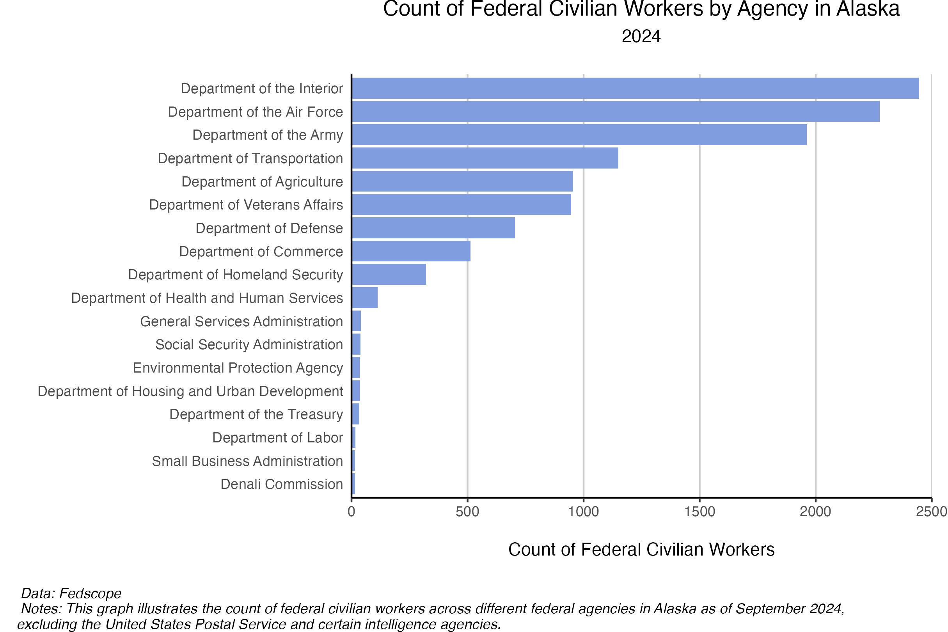

Slide 13
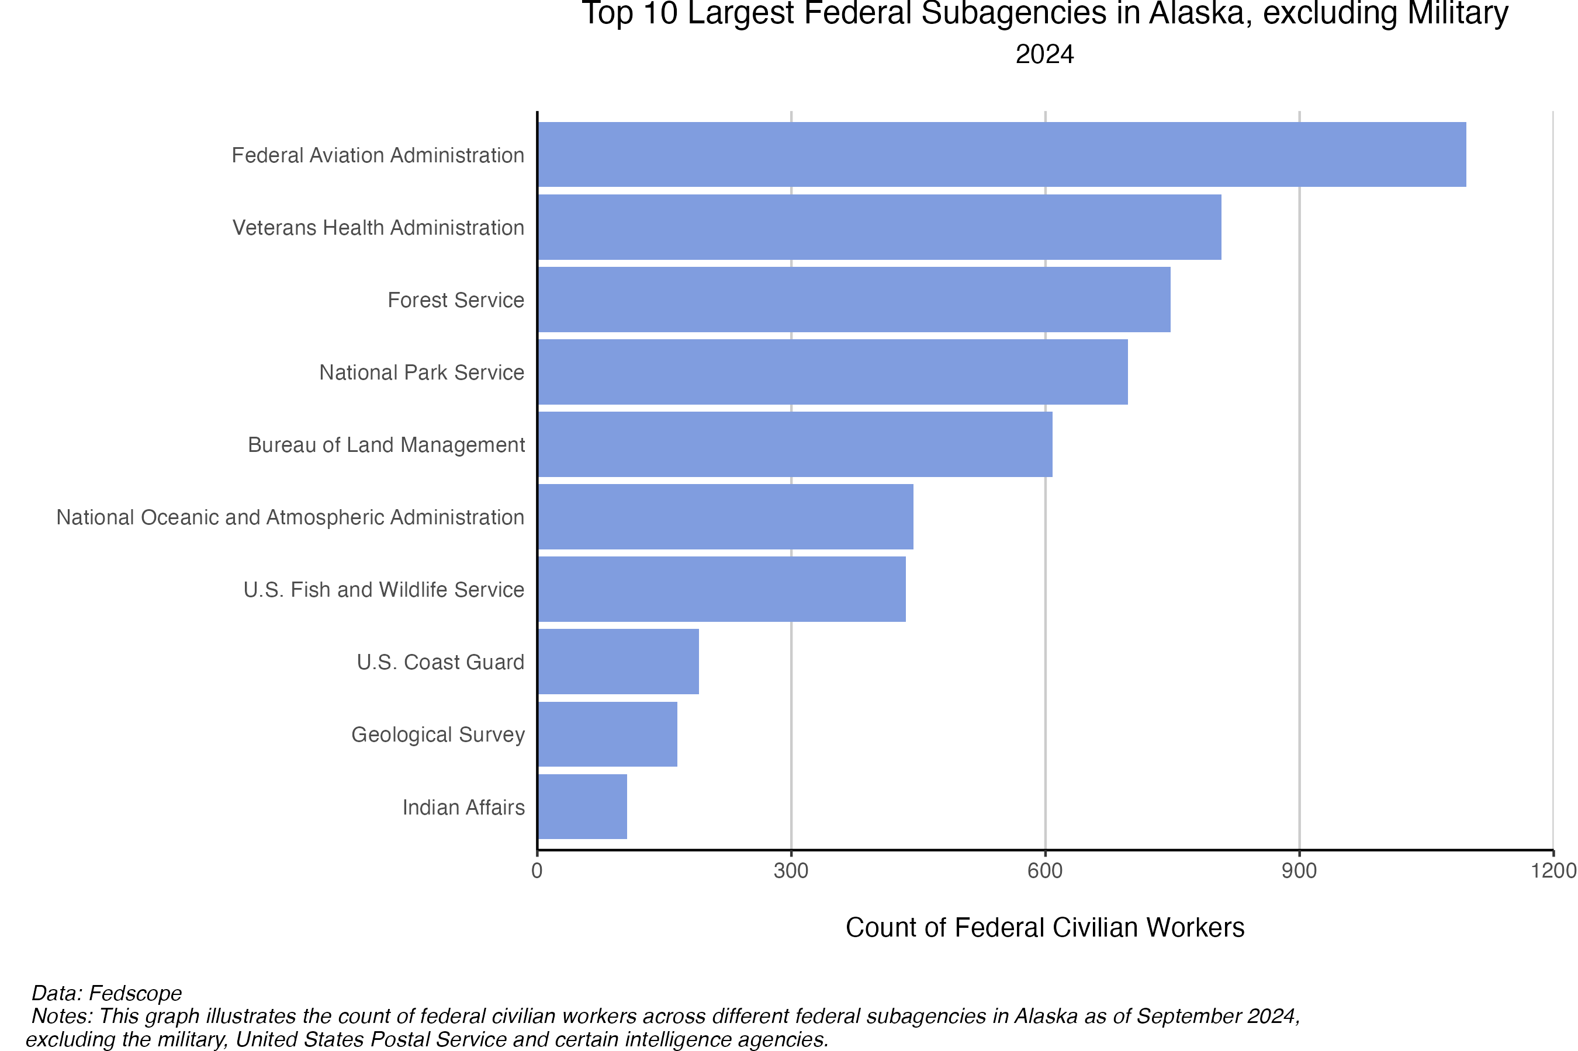

Slide 14
01
Policy movement in D.C.

Slide 15
Four Channels
1
Deferred resignation
“Fork in the Road” buyout
2
Probationary terminations
Aimed at the newest and recently promoted
3
Reductions in force (RIFs)
The formal layoff process agencies were ordered to plan and execute
4
Hiring freeze
Significantly reduced hiring of federal workers
UAA · ISER | Federal Workforce in Alaska
Notes:
One paid people to leave, one pushed people out, one laid people off, one rewired the rules. The first three are measurable in the data; the fourth is the closing point.

Slide 16
Four Channels
Buyout (DRP)
VOLUNTARY
Reduction in force (RIF)
INVOLUNTARY
Resign now, keep pay for months
Voluntary
Appealed to experienced, mid-career staff
The formal layoff: notice, seniority, bumping rights
Slow and rarely used
Erased whole offices, not individuals
Probationary termination
INVOLUNTARY
Hiring freeze
INFLOW
Firing of the newest hires, who lack appeal rights
The national headline
Hit the least experienced, most vulnerable
Stops new people from arriving
Workforce then shrinks through attrition
No one is fired
UAA · ISER | Federal Workforce in Alaska

Slide 17
What’s Changed from April 2024 to April 2026?
−14.8%
−15.8%
net change in the U.S. federal civilian workforce,
April 2024 → April 2026
net change in in Alaskan federal civilian workforce
April 2024 → April 2026
Matched universe excludes DoD/DHS/DOJ on both sides for measurement consistency. April snapshots bracket the full episode, past the Sept. 30, 2025 buyout cliff.
UAA · ISER | Federal Workforce in Alaska

Slide 18
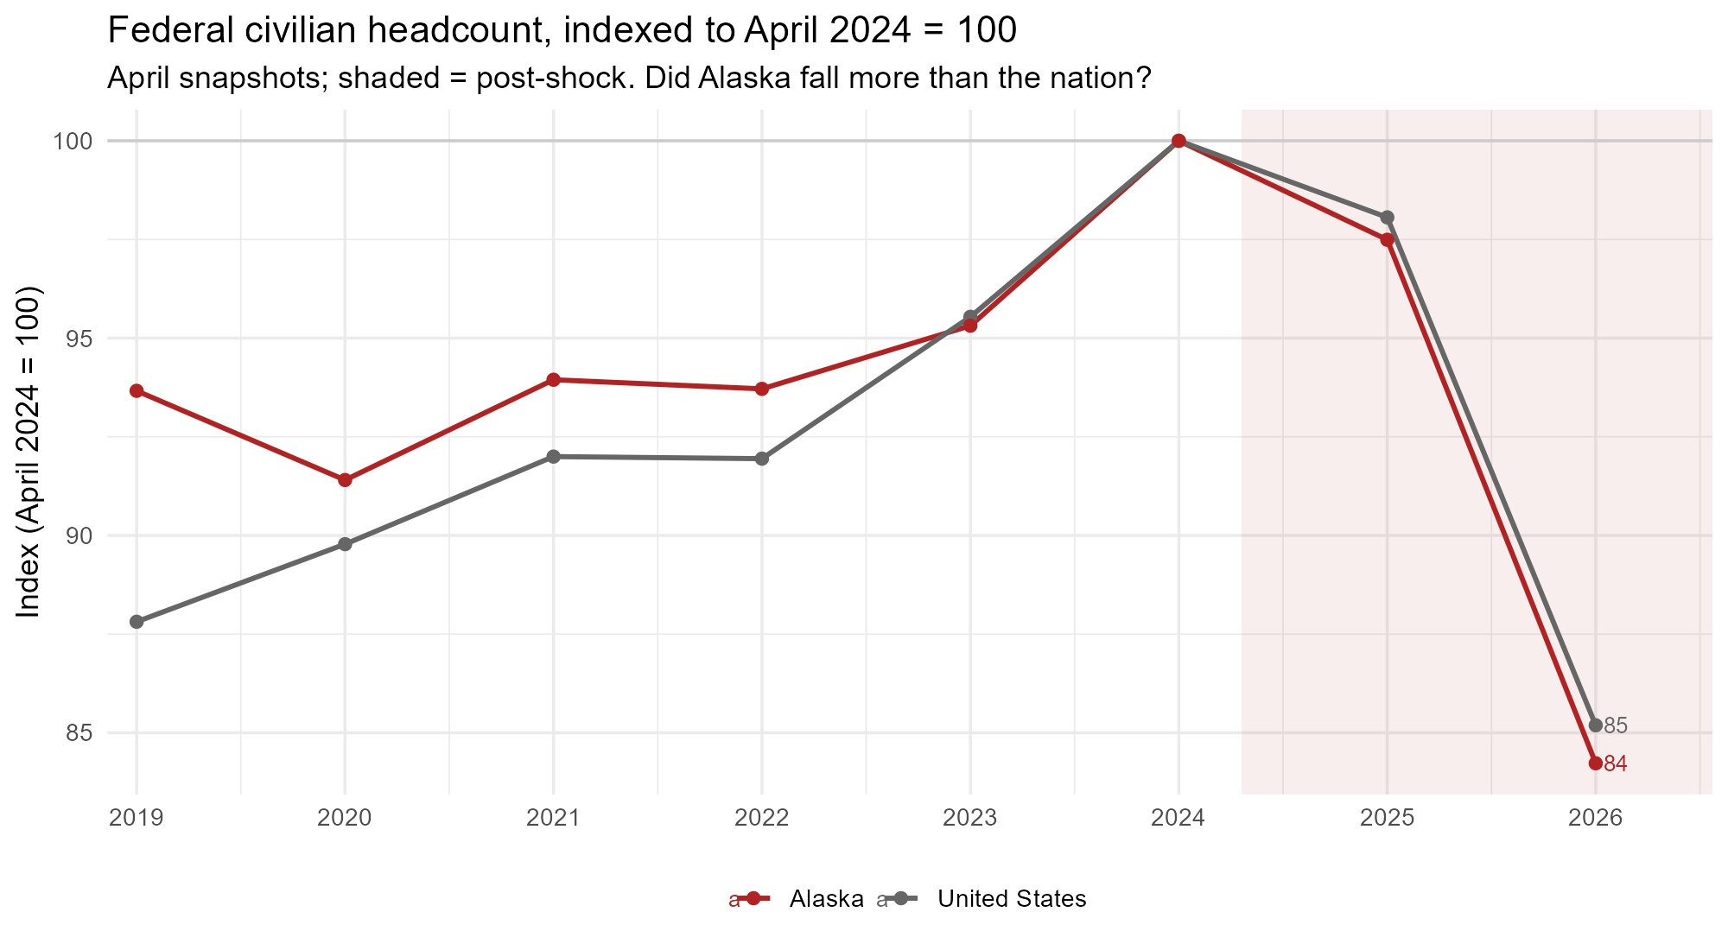
Each line is its own headcount rebased to 100 in April 2024. Below 100 = smaller than before the shock.
UAA · ISER | Federal Workforce in Alaska
Notes:
Alaska (index 84) fell a touch more than the nation (85), but the trajectories are nearly identical — this was a national contraction Alaska shared, not an Alaska-specific event.

Slide 19
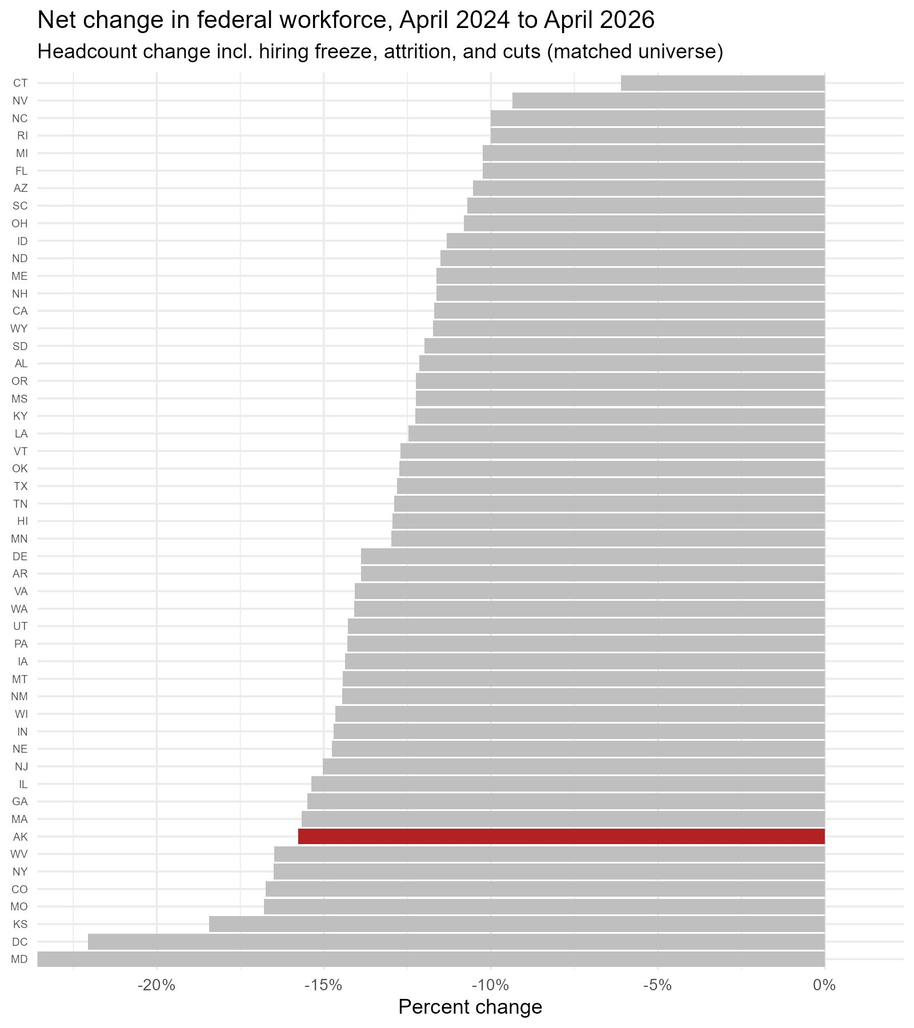
Alaska's federal workforce fell 15.8%.
That is steeper than the national 14.8% and near the bottom of the table — alongside Maryland, D.C., and the capital-region states, but for very different reasons.
Net headcount change, April 2024 → April 2026, matched universe (excl. DoD/DHS/DOJ). All states shown; Alaska in red.
Notes:
Note Alaska sits among MD/DC/KS/MO — but those states were hit by firings and RIFs, while Alaska's decline runs through buyouts and attrition. Same outcome, different mechanism.

Slide 20
02
National-level changes

Slide 21
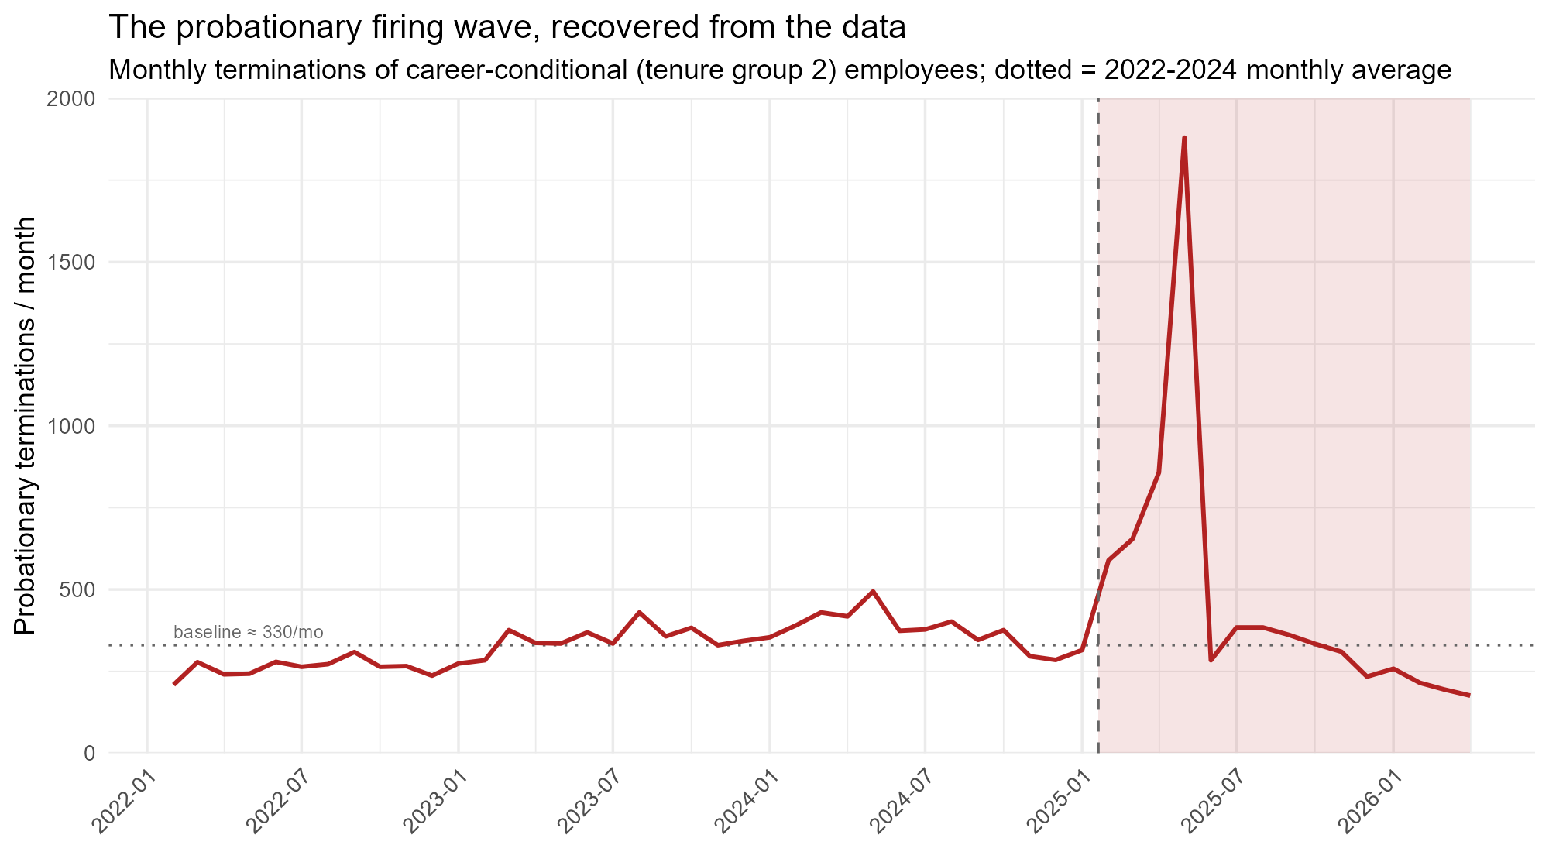
National probationary terminations
Probationary proxied by tenure group 2 (career-conditional) separations coded as terminations — overcounts strict probationers. Dashed line = Jan 20, 2025 hiring freeze; shaded = Feb–May 2025.
UAA · ISER | Federal Workforce in Alaska
Notes:
Nationally the firing wave is unmistakable — monthly probationary terminations spike to roughly 1,800 in spring 2025, far above the pre-2025 baseline.

Slide 22
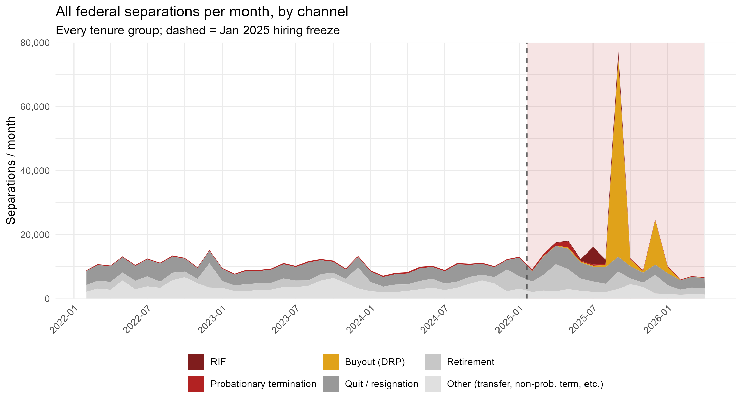
National separations
Notes:
Nationally the firing wave is unmistakable — monthly probationary terminations spike to roughly 1,800 in spring 2025, far above the pre-2025 baseline.

Slide 23
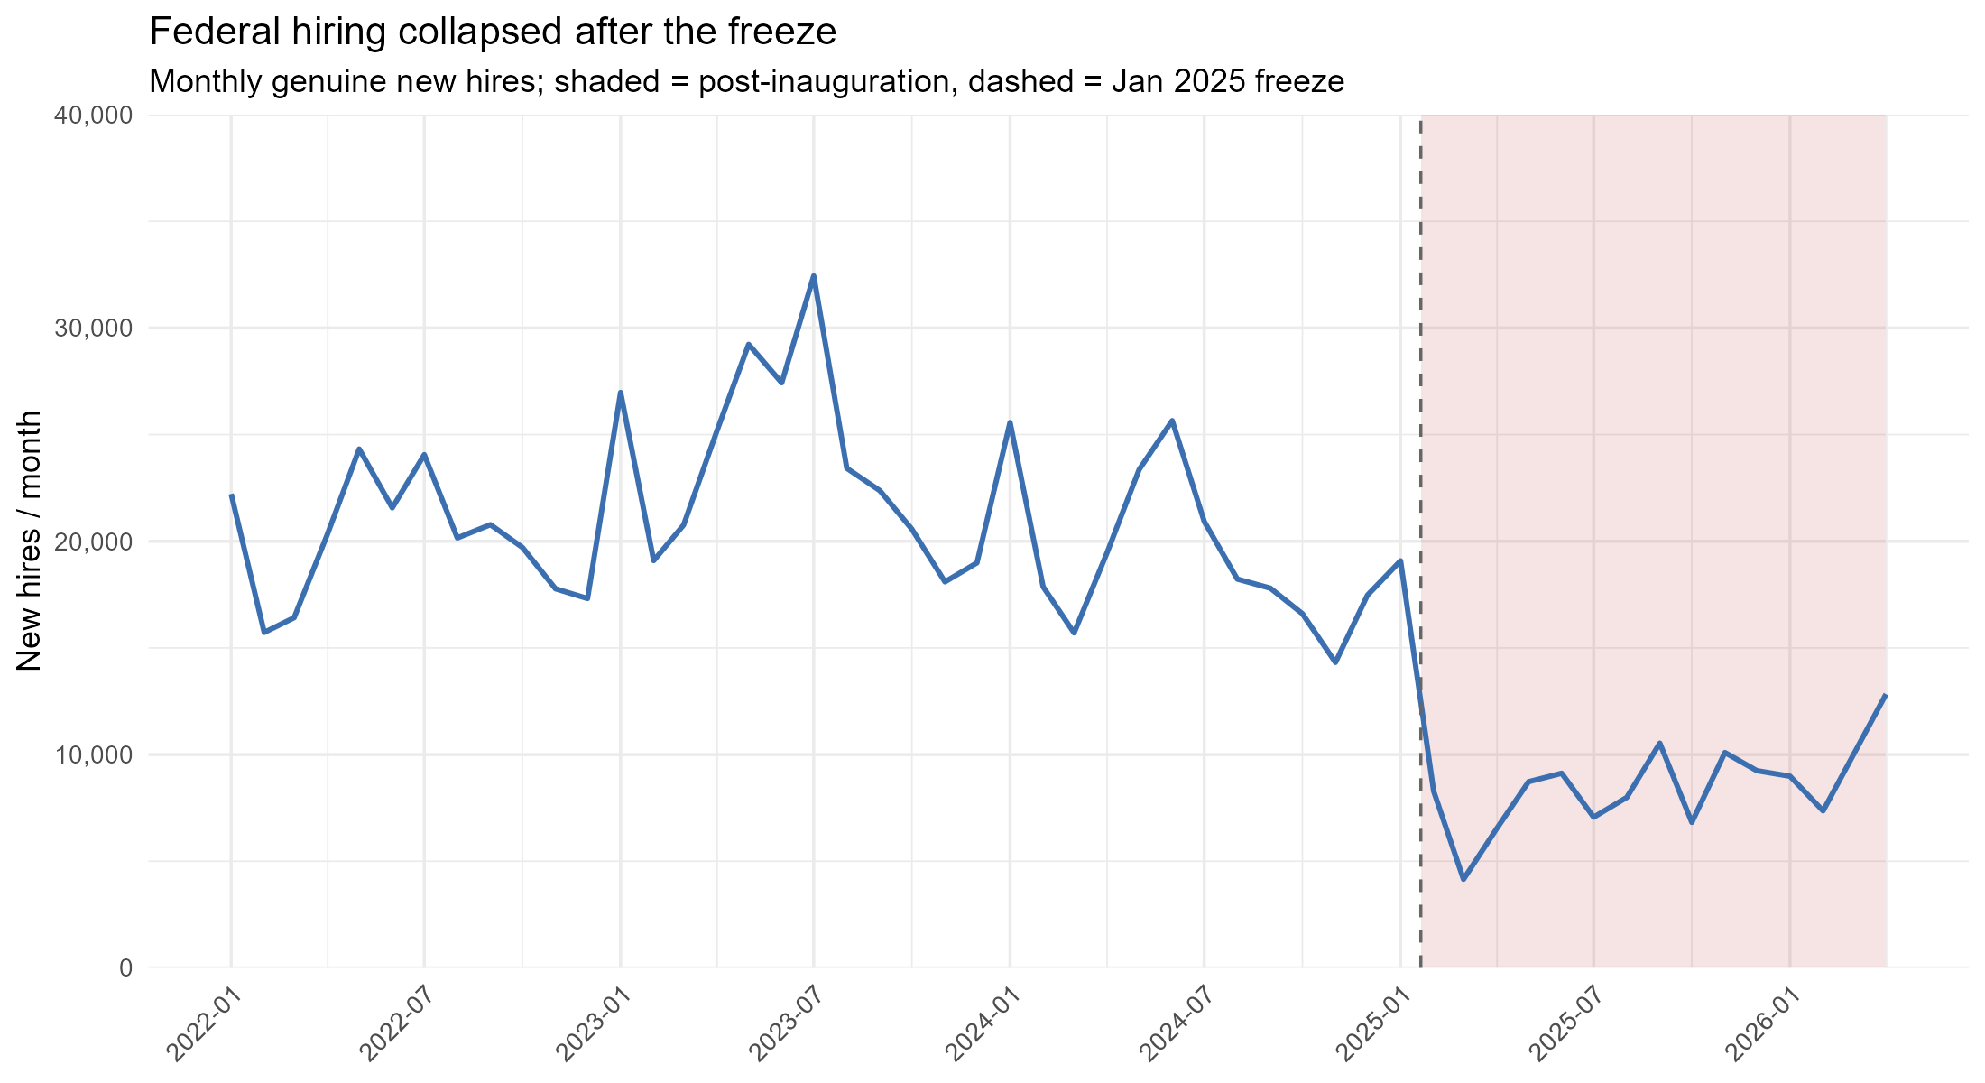
National hiring
Notes:
Nationally the firing wave is unmistakable — monthly probationary terminations spike to roughly 1,800 in spring 2025, far above the pre-2025 baseline.

Slide 24
03
Alaska-specific changes

Slide 25
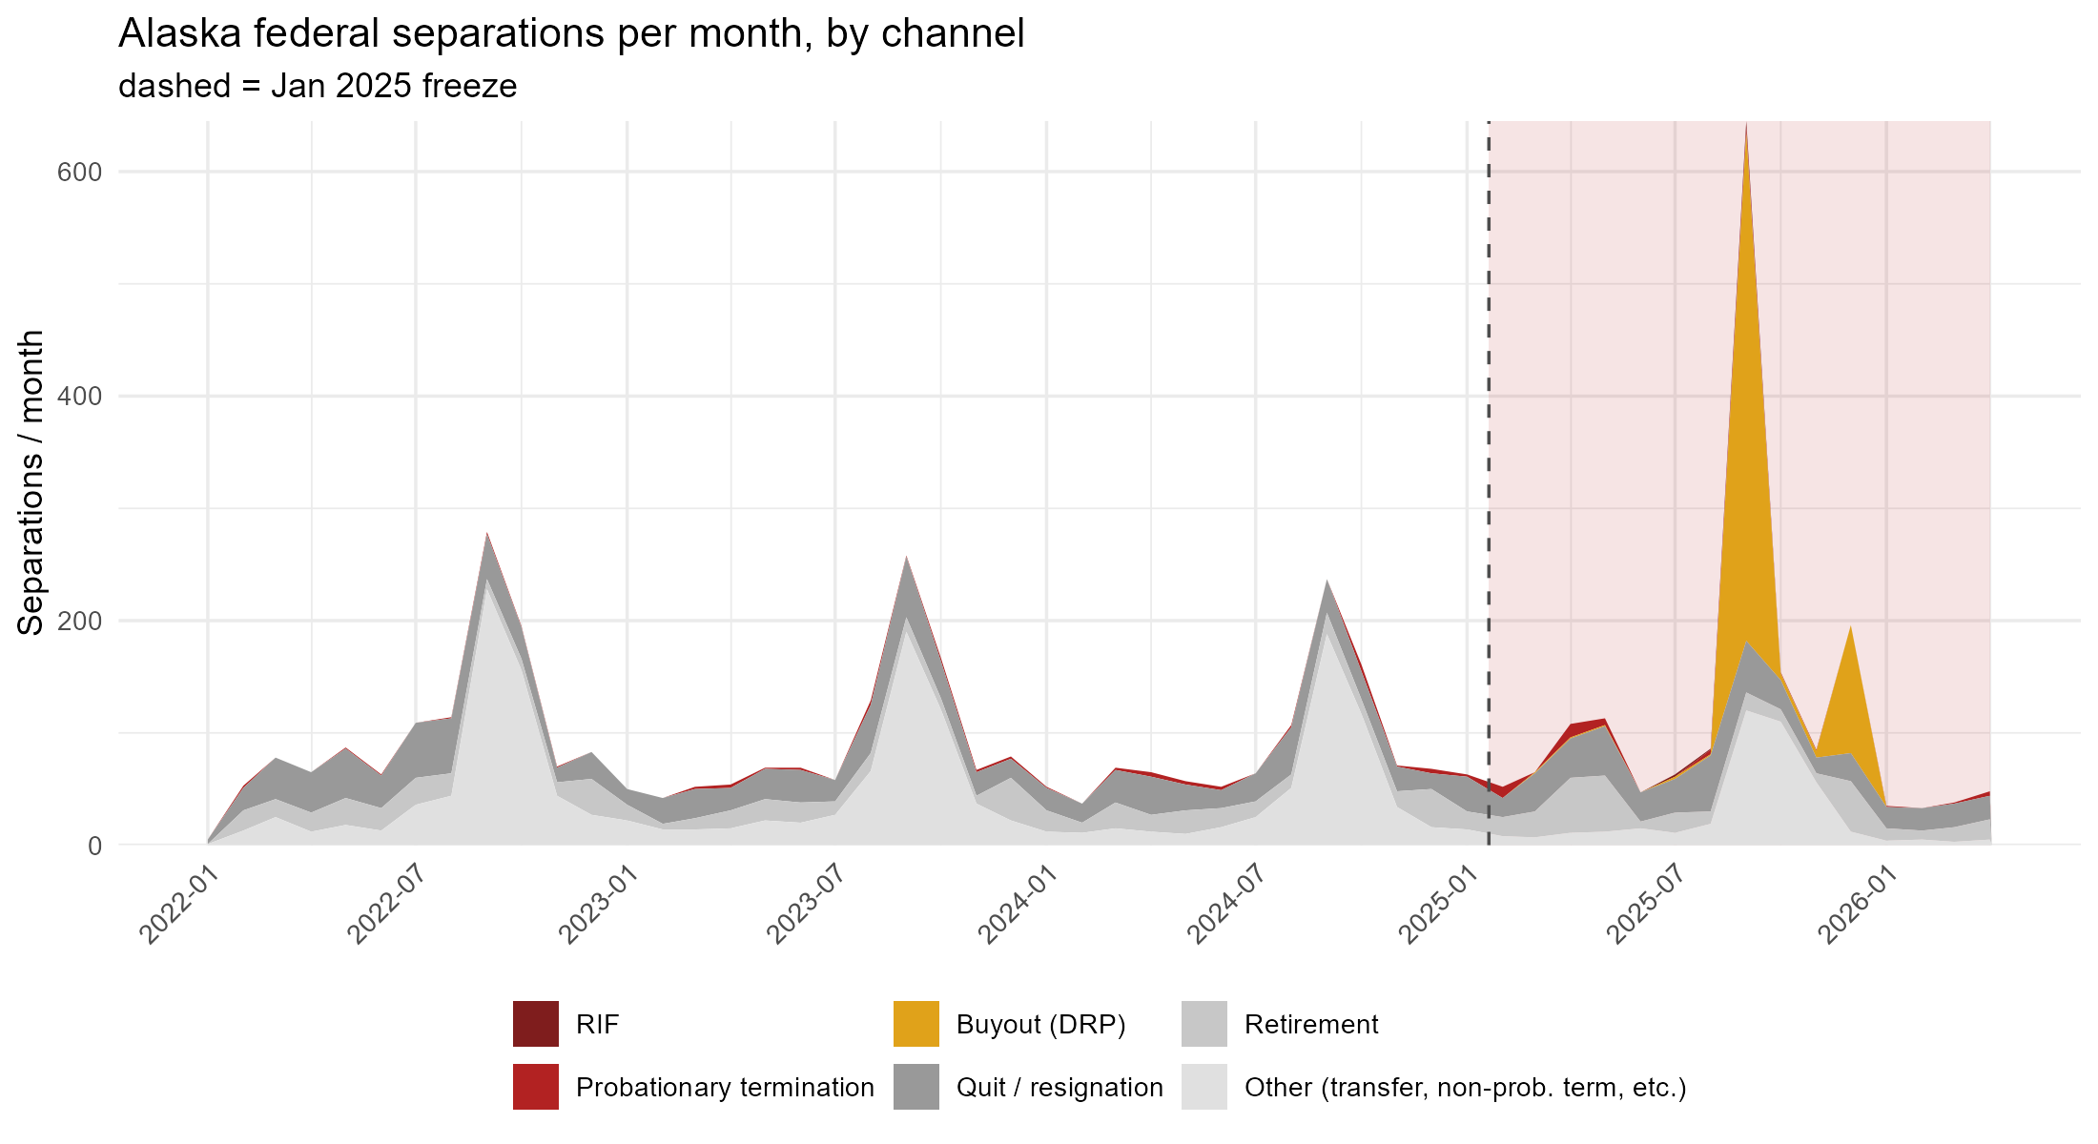
Alaska separations
Notes:
Nationally the firing wave is unmistakable — monthly probationary terminations spike to roughly 1,800 in spring 2025, far above the pre-2025 baseline.

Slide 26
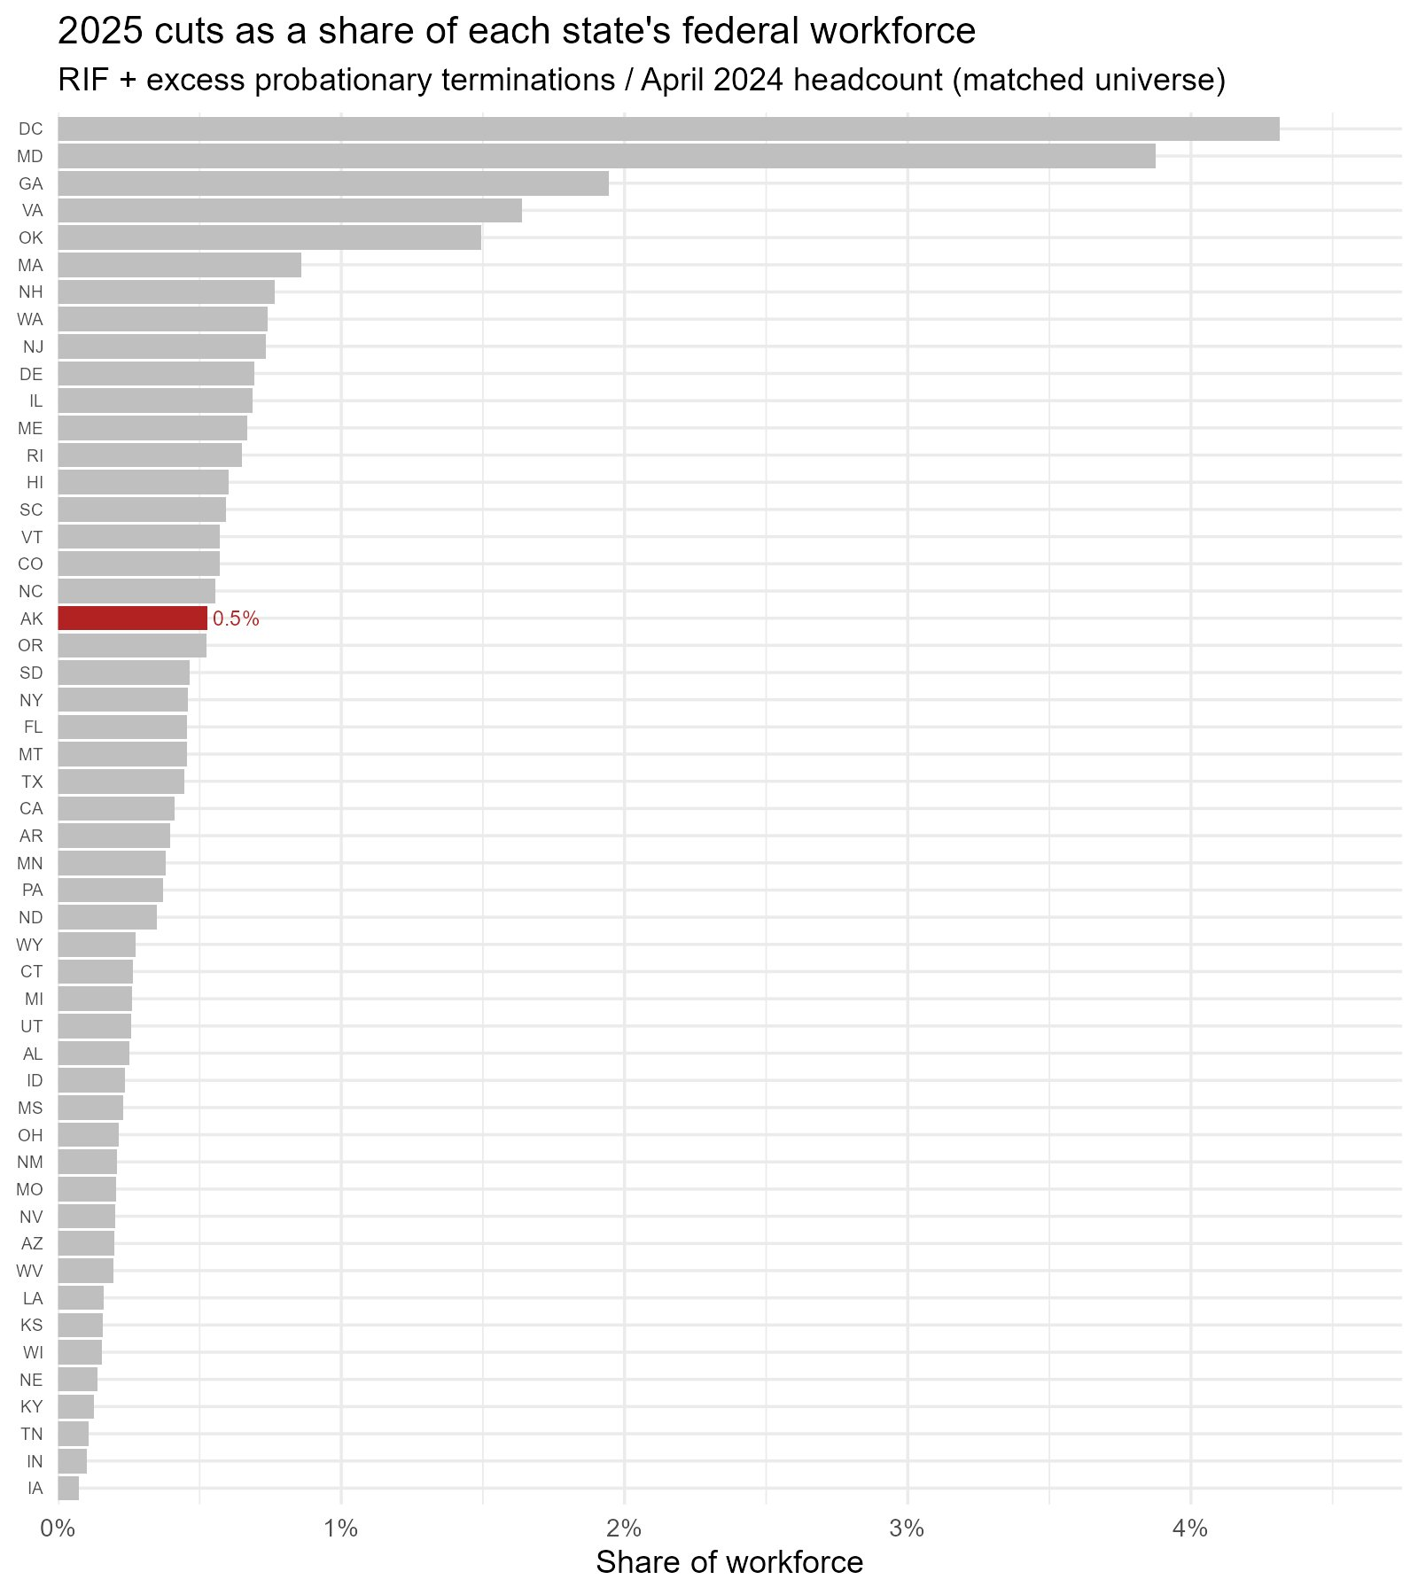
0.5% of Alaska's workforce were cut.
Far below D.C. (4.3%), Maryland, Georgia, and Virginia. The probationary-firing and RIF tools were aimed at the capital region, not Alaska.
Cut-attributable (RIF + probationary terminations above the 2022–24 baseline) ÷ April-2024 headcount, matched universe. Alaska in red.
Notes:
Reinforce the reframe: the cut tools concentrated where the agencies are headquartered, not in the field states.

Slide 27
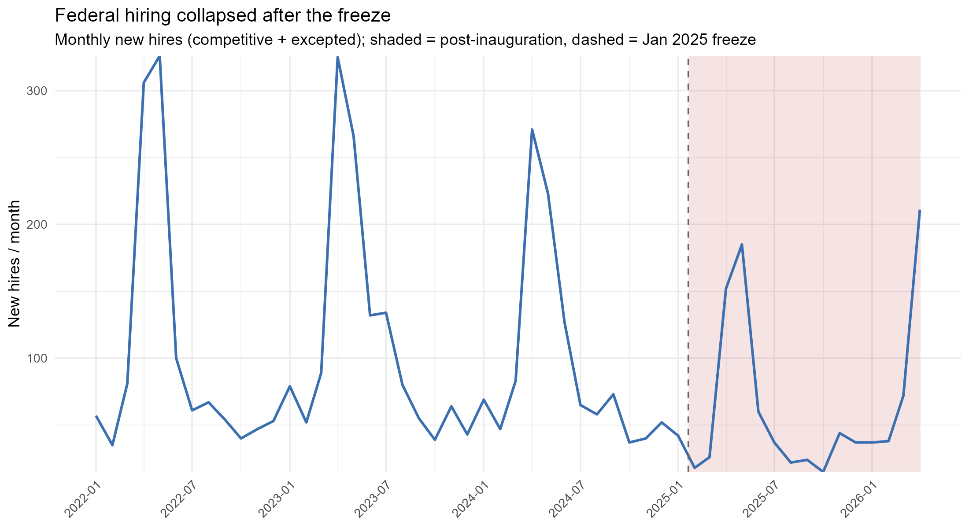
Alaska hiring
UAA · ISER | Federal Workforce in Alaska
Notes:
Separations spiked in 2025 while hiring stayed flat under the freeze — so the net line plunges. The losses came from people leaving and not being replaced, more than from mass firings.

Slide 28
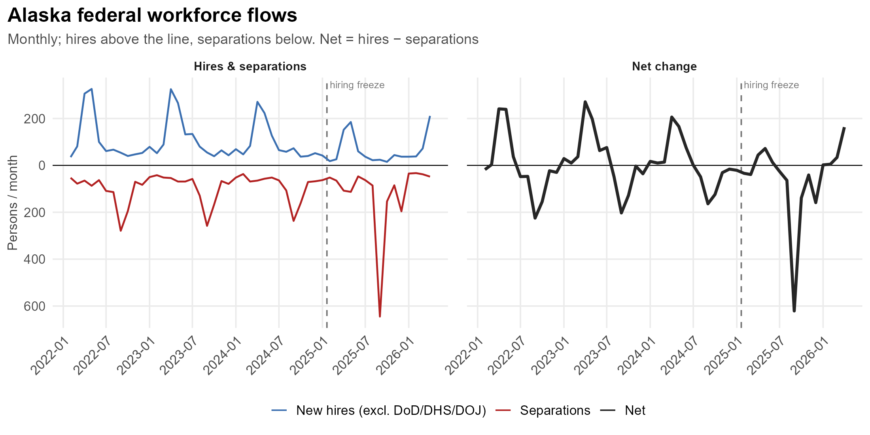
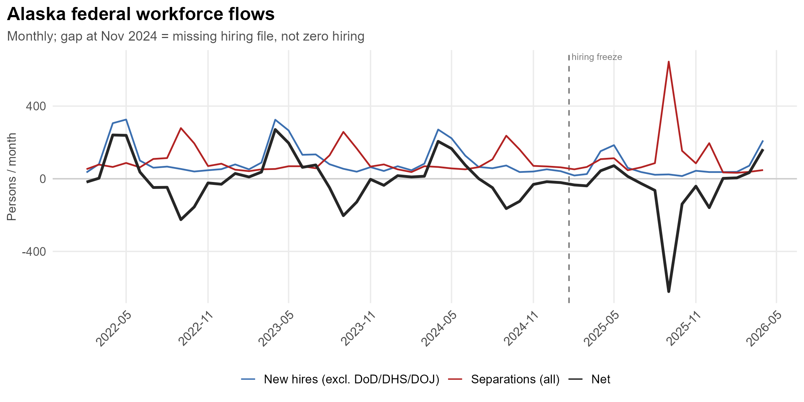
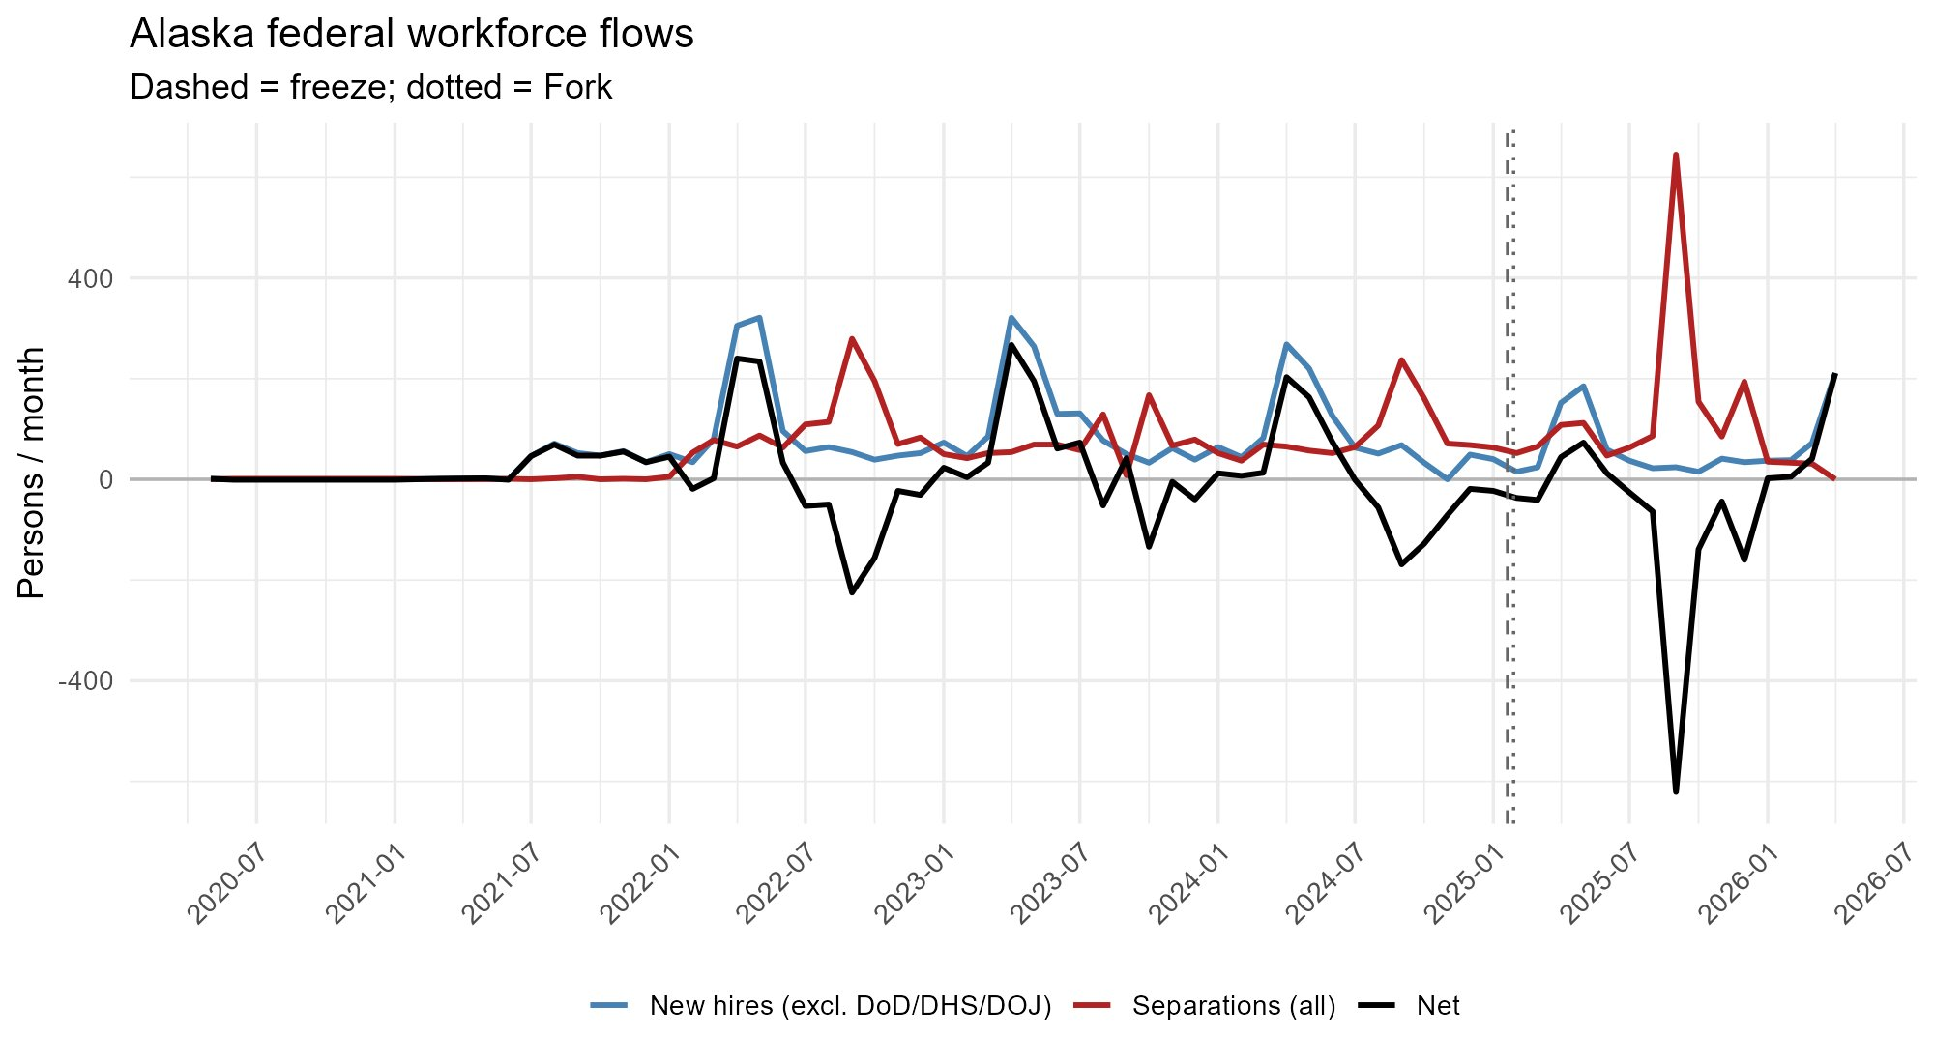
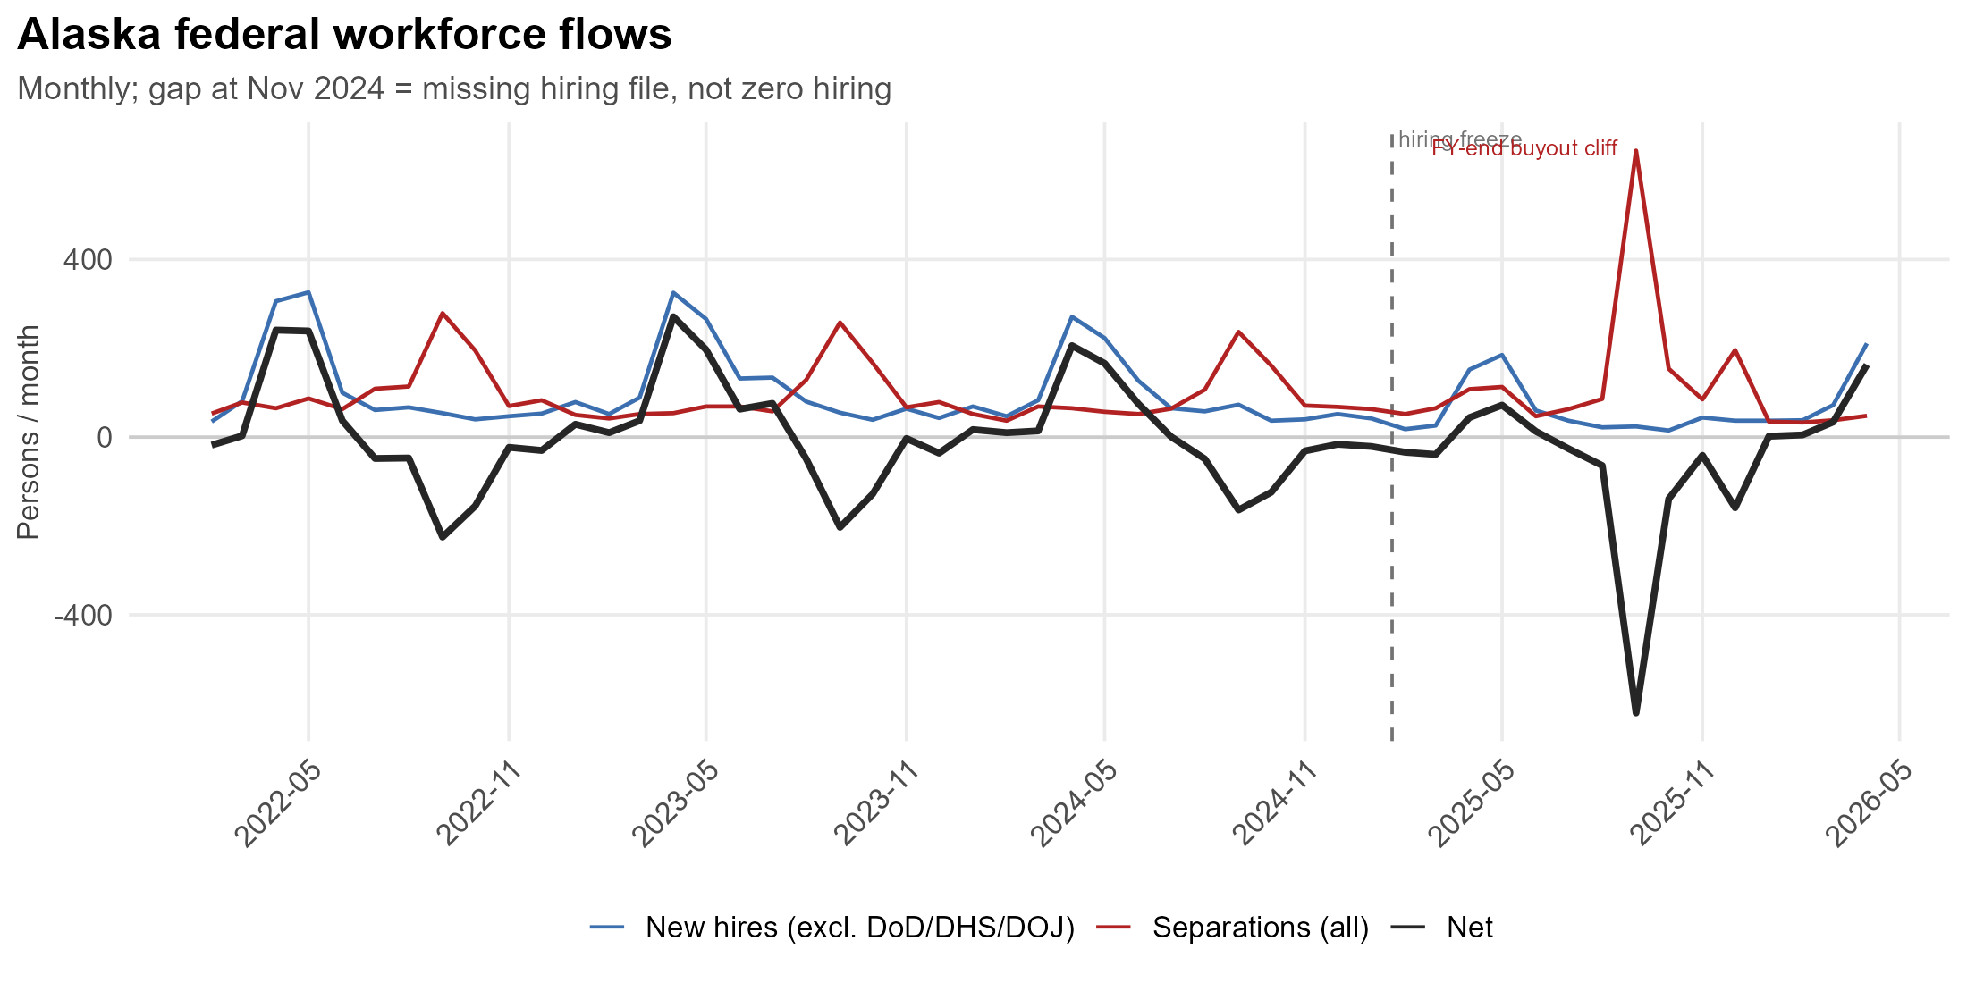
Monthly new hires (excl. DoD/DHS/DOJ), separations, and net change for Alaska duty stations. Dashed = hiring freeze
UAA · ISER | Federal Workforce in Alaska
Notes:
Separations spiked in 2025 while hiring stayed flat under the freeze — so the net line plunges. The losses came from people leaving and not being replaced, more than from mass firings.

Slide 29
04
What part of the workforce separated?

Slide 30
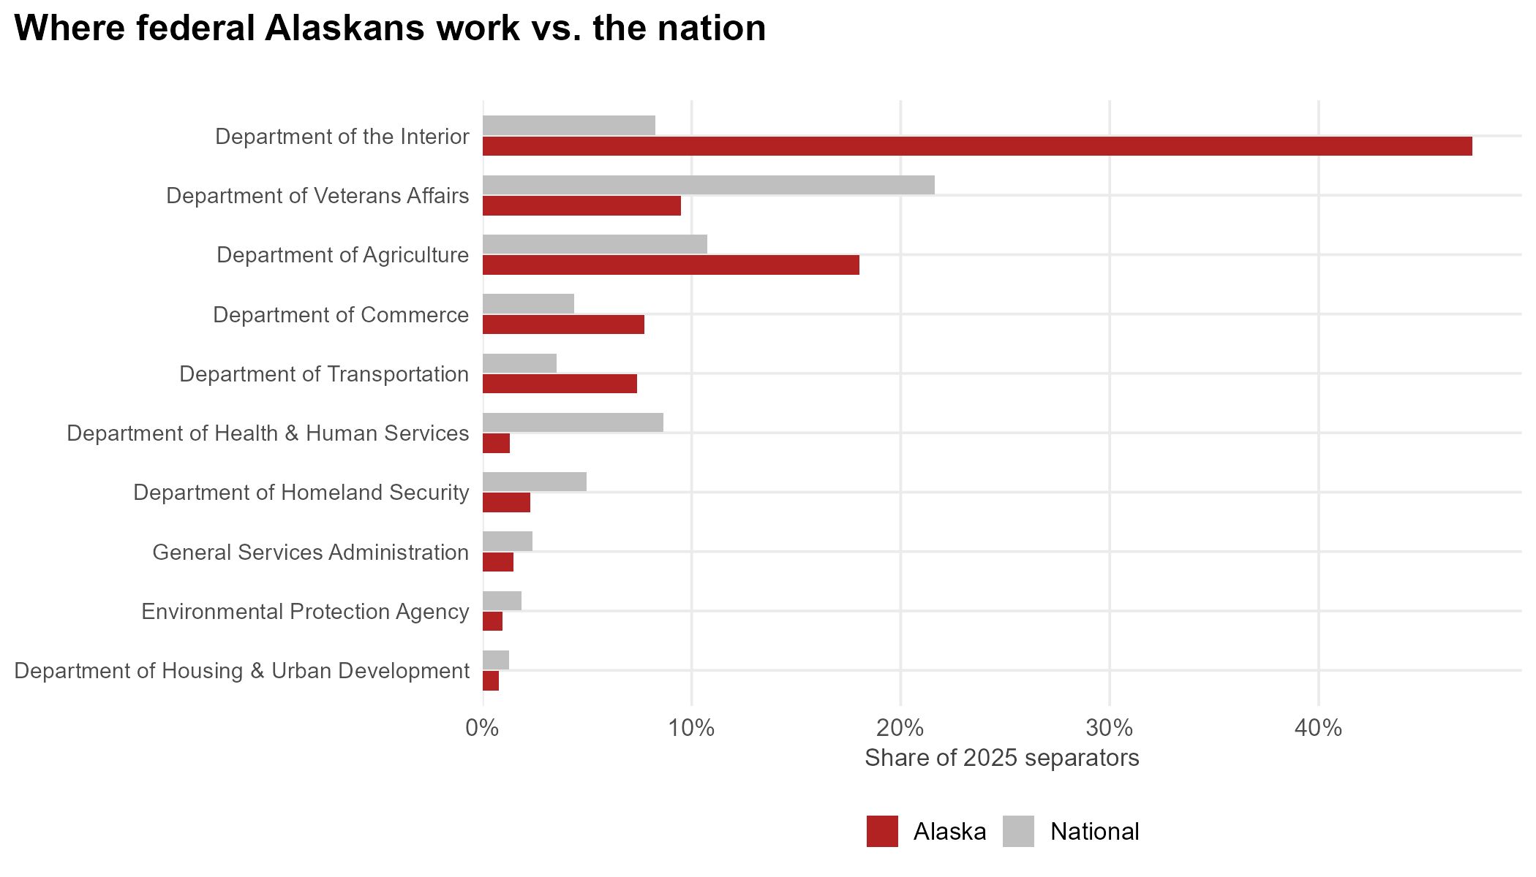
Where was the reduction concentrated?
Each agency's share of 2025 separators, Alaska (red) vs national (grey).
UAA · ISER | Federal Workforce in Alaska
Notes:
Interior alone is about 47% of Alaska's separators, with Agriculture and Commerce close behind — the land, resource, and fisheries agencies, not Washington administration.

Slide 31
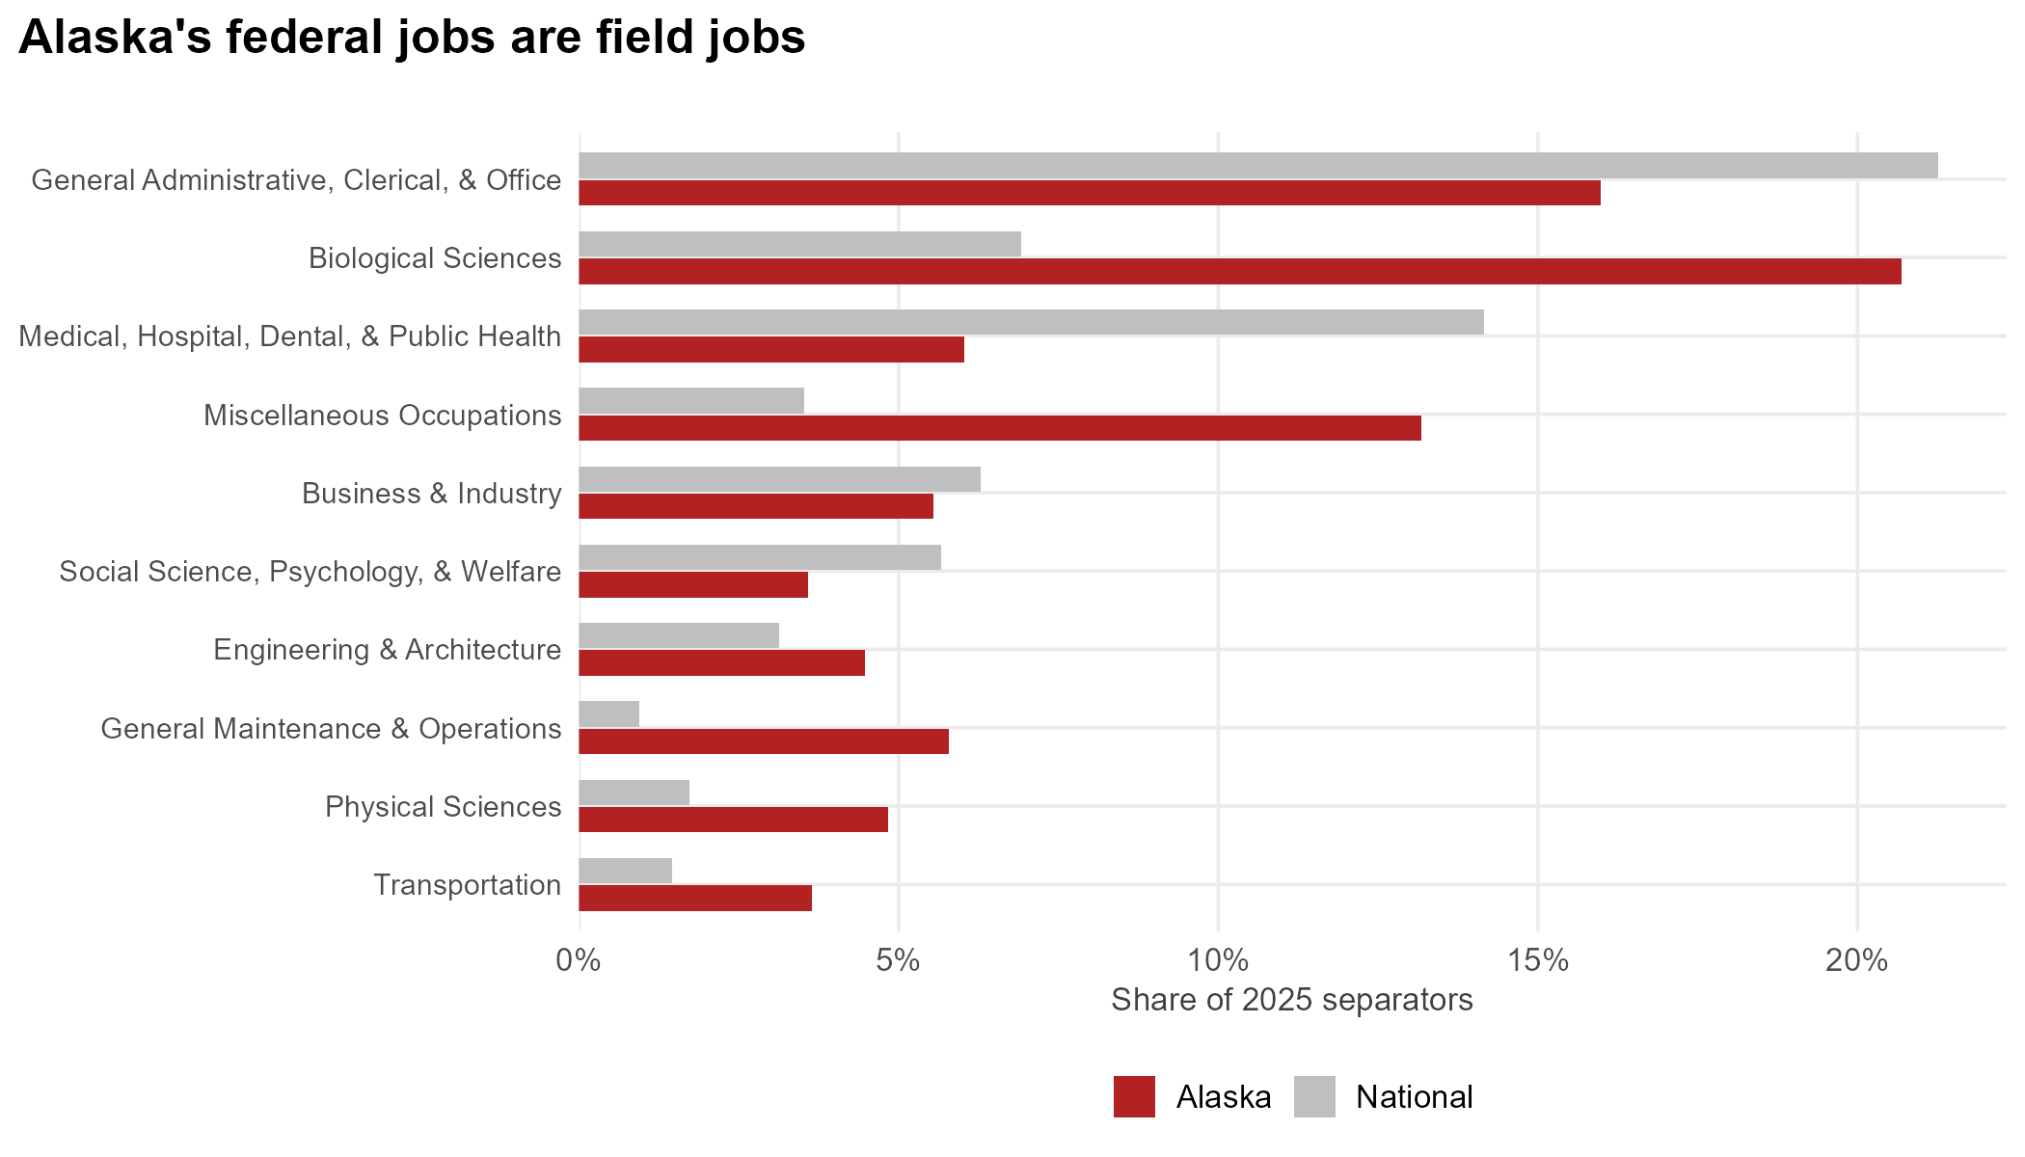
What occupations were lost?
Occupational-group share of 2025 separators, Alaska (red) vs national (grey).
UAA · ISER | Federal Workforce in Alaska
Notes:
Biologists, field technicians, resource managers, and maintenance/operations are far over-represented in Alaska — the people who run public lands, fisheries science, and wildfire response.

Slide 32
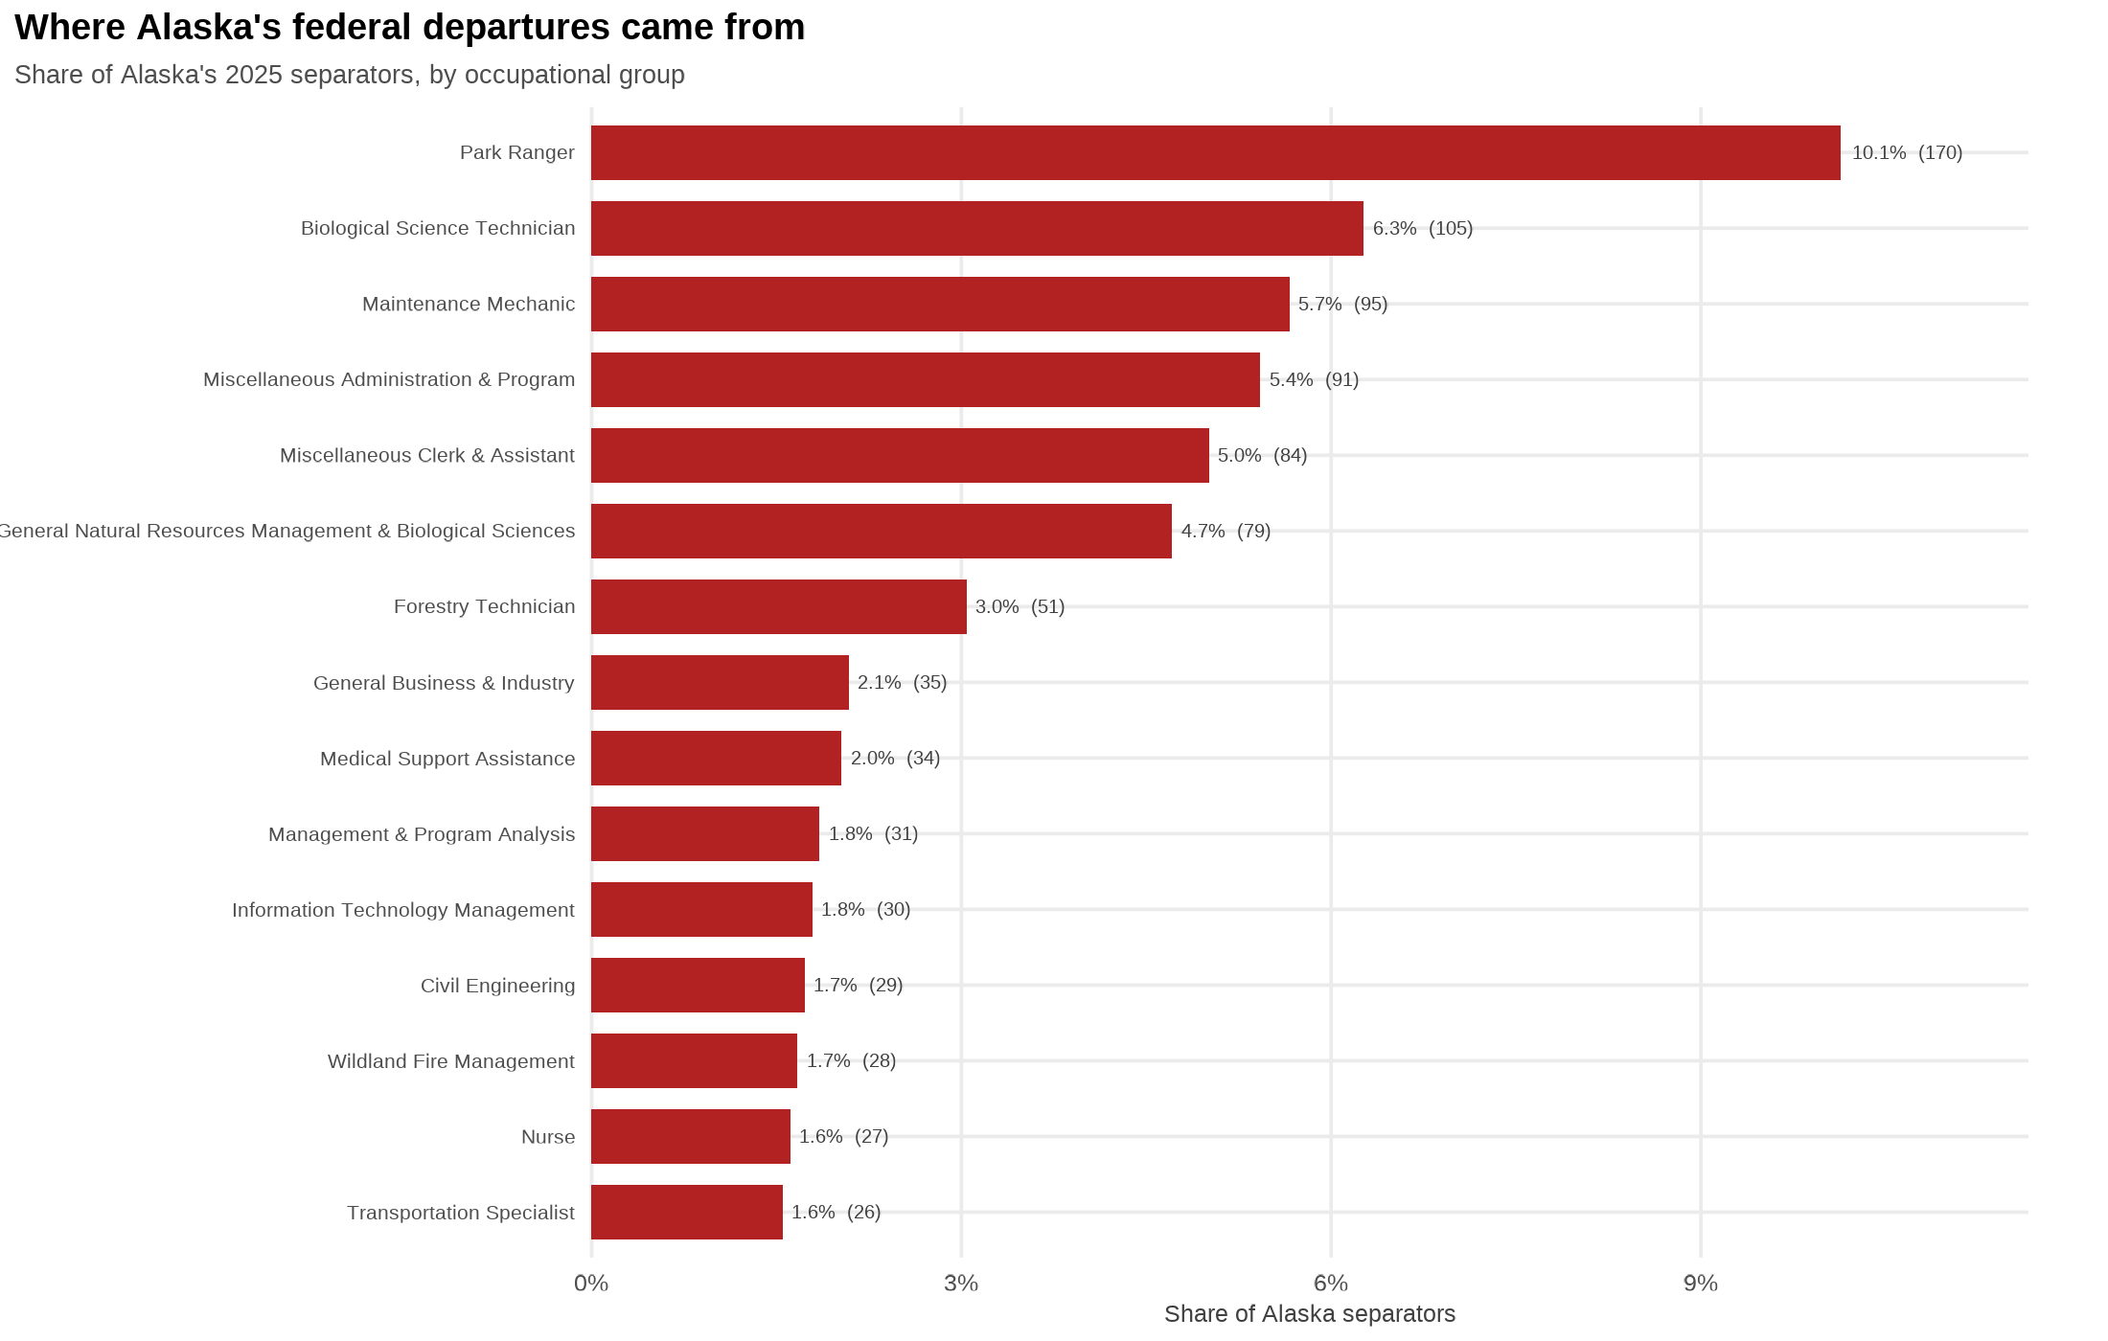
What occupations were lost?
UAA · ISER | Federal Workforce in Alaska
Notes:
Biologists, field technicians, resource managers, and maintenance/operations are far over-represented in Alaska — the people who run public lands, fisheries science, and wildfire response.

Slide 33
What’s changed?
The headcount drop is partly attrition and partly a hiring freeze
There may be structural changes to federal workers going forward— easier removal of probationary and policy-adjacent employees
For Alaska, the loss is experience and capability: nine-year veterans who took the buyout and won't be quickly replace
UAA · ISER | Federal Workforce in Alaska
Notes:
Close on the distinction between the transitory headcount number and the durable rule change, and the capability loss specific to Alaska's field functions.

Slide 34
05
Appendix

Slide 35
Data & methods
Sources: OPM separation and accession micro-data; April federal employment snapshots, 2019–2026.
Channels: deferred resignation (flagged), RIF and probationary terminations (separation category + tenure group 2), retirements, quits, transfers.
Cut-attributable: RIF + probationary terminations above the 2022–24 baseline, floored at zero (a lower bound).
Matched universe: excludes DoD/DHS/DOJ on both sides of every ratio, since their duty stations aren't consistently geocoded.
Caveats: tenure group 2 overcounts strict probationers; a probationary employee removed by RIF counts as RIF; the April-2026 snapshot is provisional.
UAA · ISER | Federal Workforce in Alaska

