Slide 1
Commonwealth North
Panel Discussion
The Alaska Gasline
Fiscal Questions & Alaska’s Energy Future
Policymaker Considerations
Senator Cathy Giessel (Dist. E–Anchorage)
Senate Majority Leader & Senate Resources Committee Chair
June 5, 2026

Slide 2
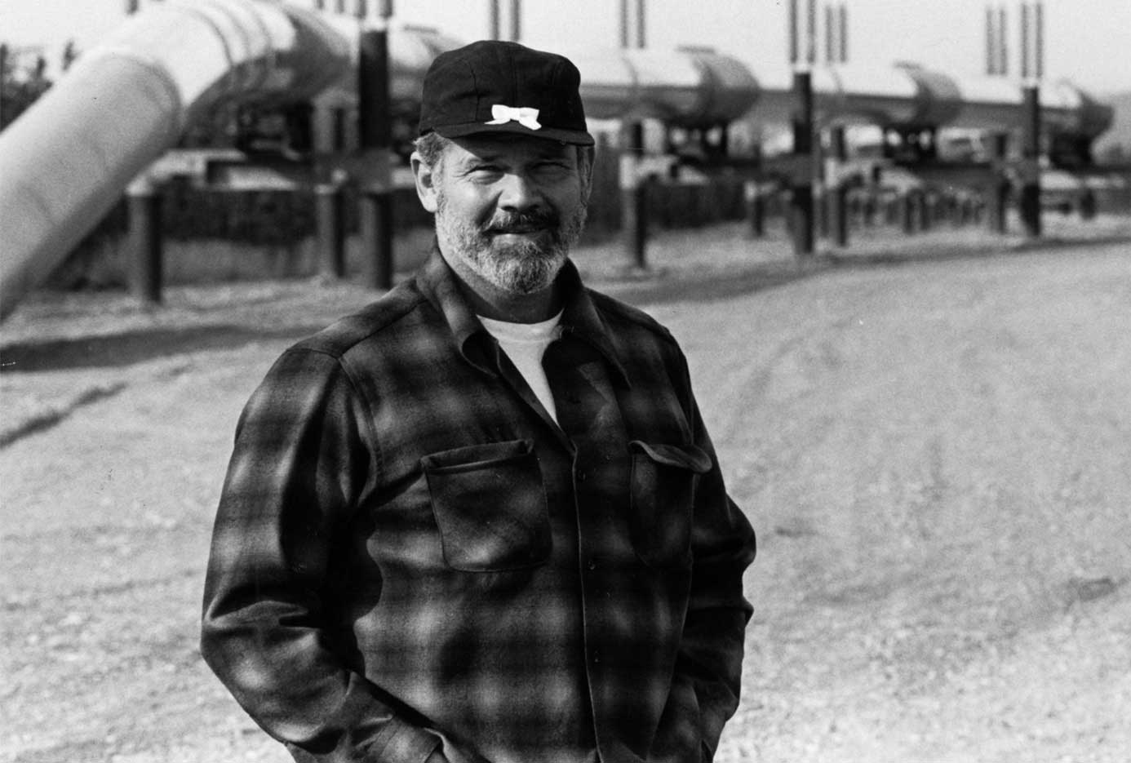
Jay Hammond, Governor 1974-1982 during our oil boom and initial rise to economic prosperity:
While the gush of oil wealth in the late 1970s provided the potential for financing state government, the jury is still out as to whether we have the ability to administer state government prudently. Perhaps the best inducement, indeed obligation to do so, lies in Article 8, Section 2, of Alaska’s constitution . . .
Diapering the Devil (2011), p. 7
The Legislature’s decisions must be guided by its fiduciary duties and Constitutional pledge to the people of Alaska
“
1

Slide 3
Alaska Constitution, Article 8, Section 2:
The legislature shall provide for the utilization, development, and conservation of all natural resources belonging to the State, including land and waters, for the maximum benefit of its people.
Congress, debating Alaska Statehood, bestowed our new state its land and mineral rights with an intent to monetize them to ensure success:
“In some respects, the most serious [problem facing Alaska] of all—is that of financing the basic functions of State government.”
“To attain this result, the State is given the right to select lands known known or believed to be mineral in character . . . It is also specifically given the right to select lands which may now be under lease for oil and gas or coal development . . . ”
- H.R. 7999 H. Rept. No. 624, 85th Congress, 1st Session, June 25, 1957
2

Slide 4
“I feel . . . that this amount of land is needed in order to give the new State a sufficient tax base to allow a reasonable assurance of its future existence.”
-Representative William Dawson, Utah
“[I]f you want to develop [the resources of] a territory, turn it over to the State and let us hope that there is wise economic and political leadership in the State so that they, in turn, will turn it back to the people who will come there from every state in the Union.”
-Representative Arthur Miller, Nebraska
3

Slide 5
On March 20, the Governor introduced SB 280:
  Complete petroleum property tax relief from State & Municipal taxes
  For 10 years of commercial operations or until 1.0 Bcf/day
  Then $0.06/Mcf Alternative Volumetric Tax (AVT)
  Distributed to communities via Department of Revenue regulations
  1% annual “inflation” adjustment
  Revenue estimate $74 million annually, or 90% tax cut at full operations
The Legislature was challenged with vetting the policy and mechanics of SB 280, examining and scrutinizing the AGDC/Glenfarne transaction, and weighing the best interests of Alaska’s impacted communities and the State.
4

Slide 6
Legislative Policy Considerations & Concerns
• Protections for Alaskan ratepayers
• Protections for Alaskan communities – along the corridor & statewide
• Increased AGDC oversight and transparency
• Statutory State option contract & equity investment procedures
5

Slide 7
Legislative Policy Considerations & Concerns, continued
• Revenue measures to offset construction- related costs and losses and obtain the value of our public gas resources for Alaskans
• Contingency provisions, e.g., if the project does not move forward, and repealing the abatement laws when the project is viable, successful, and generating large revenues to the developer
6

Slide 8
Additional Policy Considerations
• Closing the pass-through entity tax loophole (“S-corp Tax”) in light of the substantial profits made by the developer, an LLC
• Recent 45Q revelations regarding the State’s enacted laws and revenue share
7

Slide 9
Further Questions & Comments?
Thank you!
8

