Slide 1
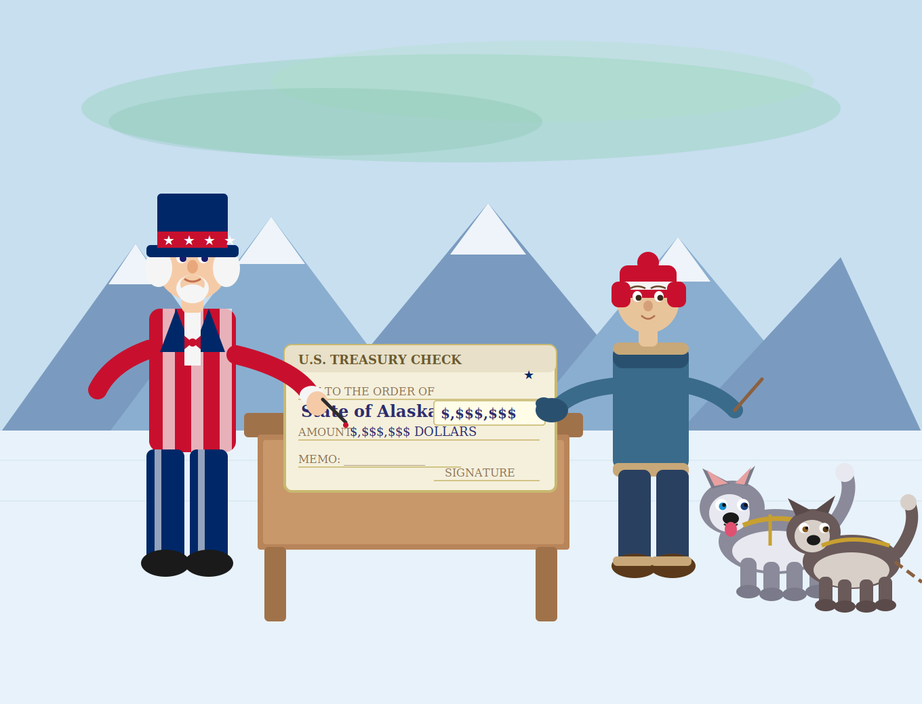

Slide 2
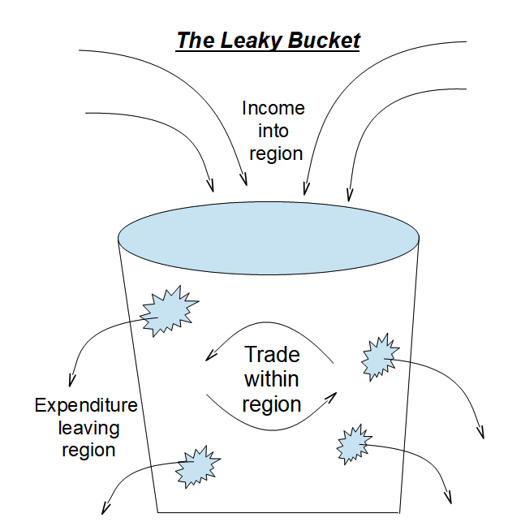
The Leaky Bucket

Slide 3
Economic Base Models
Commercial fishing
Mining; tourism
Oil exports
Cargo trans-shipment (Fedex; UPS)
Federal Government expenditures
Business supplies
(from out of state)
Imports of goods
(consumer purchases from out of state)
Out-of-state vacations
Income tax
Notes:
Vacations outside the state
Buying from catalogues
Buying from teh internet from companies physically located outside Alaska
Buying products produced outside the community.
Ex: Car (most of the expenditure will not be part of the dealer’s income)
REI:

Slide 4
Which industries bring in money from outside the Alaska?
Federal Government
Oil and Gas
Fishing
Mining
Tourism
Cargo/Permanent Fund Draw & PFD
Retirees

Slide 5
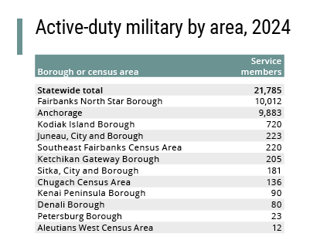

Slide 6
